Slide 1
Notes:
Teacher notes: none

Slide 2
Notes:
Teacher notes: none

Slide 3
Notes:
Teacher notes: none

Slide 4
Notes:
Teacher notes: Learning intentions (2 consecutive animations at * Click)
Sensitivity note: As their teacher, you know your own pupils well. Please feel free to edit the lesson to best suit the needs in your class.
See also our Good Practice Guidelines for teaching about poverty and development in the Teacher’s section of www.ourworldirishaidawards.ie
Ask for volunteers to read the two learning intentions for Lesson Two.
* Click to animate in the learning intentions, one after another.
Check for comprehension of tricky words, explaining as necessary.
This is the second lesson for the 2024 Our World Irish Aid Awards. It is all about what Irish Aid is and does in different countries to make sure that all people have access to sufficient, nutritious food.

Slide 5
Notes:
Teachers Notes: Activity 1: (2 animations at click)
Today we are going to learn about how Ireland helps to make the world a better place with the help of Irish Aid.
What is Irish Aid? What do you know about what they do in the world?
Have the students share their answers and make note of them. We are going to learn lots more about Irish Aid from the video and the next slide.
*Click to play the video, embedded here which will explain what Irish Aid does to support communities across the world. It can also be found online
After the videos, add to the answers you have. What do Irish Aid do to help make the world a better place?
Be sure to send us in your pupil’s answers, you can take a picture of them or send them to us digitally, to be in with a chance to be included in an issue of our Global Goal Getters Magazine!

Slide 6
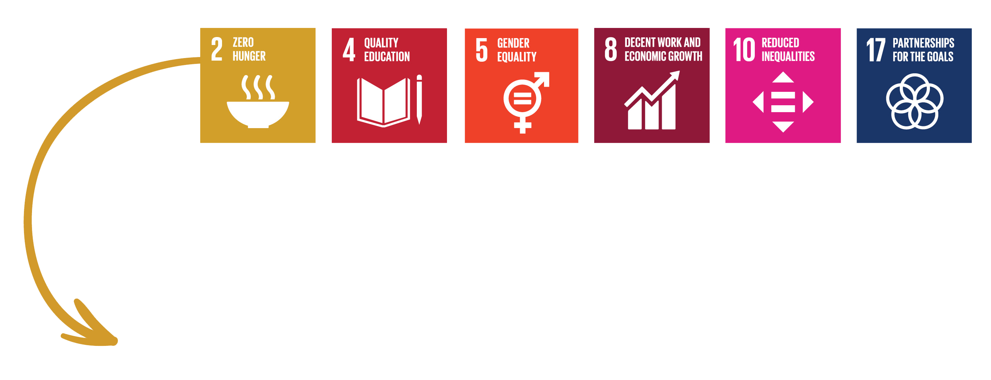
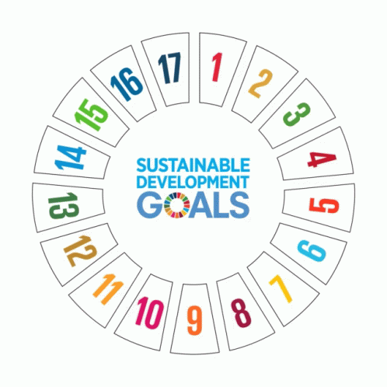
Notes:
Teacher notes: Activity 1 (Irish Aid) (3 animations at * Click)
The Government of Ireland has a programme for international development cooperation called Irish Aid. Overseas development cooperation is a tricky term. It means working to end global hunger and poverty and tackle climate change. Irish Aid does this on behalf of the people of Ireland. For this reason, it is important that we learn about Irish Aid.
Irish Aid works with international organisations like the United Nations, other governments, with non-governmental organisations (or NGOs, like Trócaire), and with communities, in countries all over our world, to try to make the Global Goals happen, so that everyone is included, treated fairly or equally so that we can all build a better world for our families.
* Click to animate in the 17 Global Goals gif
The 17 Global Goals are universal. This means that they are for everyone, especially the people who are most at risk – those who do not have enough good food or clean water or people who cannot afford to send their children to school or get medical help when they need it.
The fact that the Goals are universal means that people, like you and me, all have a responsibility to do something about the Global Goals. Countries that are considered better off, like Ireland, should support countries with less, for example, Uganda. This is what Irish Aid is trying to do.
Petelina is a farmer in Uganda. She is being supported to recover and grow wild and traditional species of foods. This means that farmers can increase the variety of food people have to eat. It also means that communities are more resilient to shocks and stresses on the environment, like drought, or poor soil or food crises. We will learn more about Petelina in lesson 3.
* Click to animate in the Goals relevant to this story of progress in Uganda.
The Global Goals that are linked to Petelina’s story are Goal 2: End hunger, Goal 4: Quality Education; Goal 5: Gender equality, Goal 8: Decent work, Goal 10: Reduced inequalities, Goal 17: Partnership for the Goals.
Find out more about Irish Aid supported work in Uganda on pages 3-7 of the 2024 pupil’s magazine and in Lesson 3 (Teacher’s section: www.ourworldirishaidawards.ie)

Slide 7
Notes:
Teacher notes: Activity 2 (Stories of progress) (no animation)
Sensitivity note: If you have pupils who have connections with one of the countries in Activity 2 (next slides), check whether they would like to contribute as you run through Slides 8-10. See our Good Practice Guidelines for Teaching about Development in the Teacher’s section of www.ourworldirishaidawards.ie
Let’s find out more about Irish Aid work to make the Global Goals a reality in countries all over our world.
NB: Slides 8-10, together with page 3-7 of the 2024 Our World Irish Aid Awards pupils magazine, includes all the information your pupils need to compete against the clock in our updated online Global Goal Spinner game, available: https://globalspinner.ourworldirishaidawards.ie/#/game/title

Slide 8
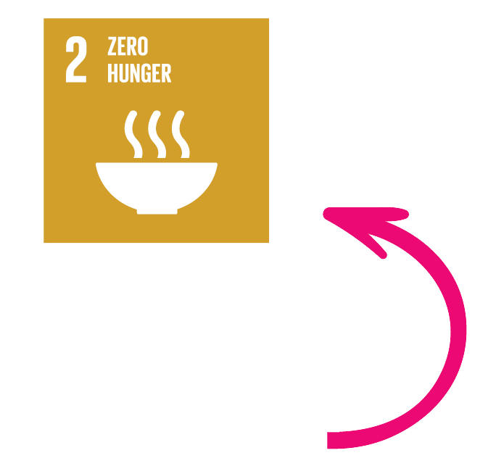
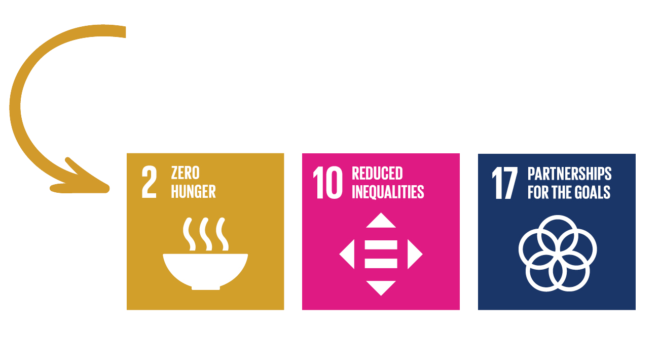
Notes:
Teacher notes: Activity 2 (Stories of progress) (1 click)
Invite 3 pupils to read the information on the slide about Ethiopia, Tanzania and Uganda. Explain any tricky words/phrases. For example, sorghum (Tanzania), or millet, is a crop that is used as an alternative to rice or turned into flour for baking etc.
Each of the examples here, tell us more about what Irish Aid is doing in the countries to support SDG 2 – Zero Hunger. By supporting this Global Goal, however, we help to achieve lots of the Goals. What else do you think ending hunger will support?
Adapt this activity to suit your class. Find the countries on a map of the world, so they can see in which continent the country is. The Irish Aid website has an information page on each of their focus countries that includes a short 1-minute video which gives a little more information. https://www.irishaid.ie/what-we-do/who-we-work-with/our-partner-countries/
Discussing what they already know about the countries and what SDG Irish Aid is targeting in each story of progress could also be an interesting activity for the children to do, linking the Global Goals directly to the work of Irish Aid. Ethiopia is already linked to the SDGs for you on the slide.

Slide 9
Notes:
Teacher notes: Activity 2 (Stories of progress) (no animation)
Invite 2 pupils to read about Malawi and Mozambique. Explain any tricky words/phrases. For example, diversification (adding variety to the crops grown) We have simplified some of the language in these stories of progress for the audience of primary school students
By supporting farmers in Malawi to have a variety of crops growing, crops that are native to their country, it helps to ensure that the people have different crops to eat. This helps to ensure that the soil improves, the health of the local people improve and the local people’s ability to have more income is also better.
What does giving people access to clean drinking water, have to do with zero hunger? What other Global Goals are being supported in Malawi and Mozambique?

Slide 10
Notes:
Teacher notes: Activity 2 (Stories of progress) (1 click)
Invite 3 pupils to read about Sierra Leone, Zambia and Vietnam. Explain any tricky words/phrases including stakeholders(the people affected by any decision), advocate (to speak out)
Slides 7-10, together with pages 3-7 of the 2024 Our World Irish Aid Awards pupils magazine, includes all the information your pupils need to compete against the clock in our updated online Global Goal Spinner game, available: https://globalspinner.ourworldirishaidawards.ie/#/game/title
Invite pupils to work in groups, each group take a different country and tell us the Global Goals that Irish Aid helps each country to achieve. What are the lessons we can learn in sustainable development?
After all the presentations, discuss the common themes for the countries, the differences and the importance of having different solutions in each country. (Common themes: agricultural development, food security, income generation, Local Community empowerment, Climate Change resilience), (Differences: impact of climate change, geographical differences, government involvement) There are no one-size-fits-all solutions for these situations.

Slide 11
Notes:
You can play against the clock to see your level of knowledge by playing the Global Goals Spinner on the Our World Irish Aid Award website https://globalspinner.ourworldirishaidawards.ie/#/game/title

Slide 12
Notes:
Teacher notes: Reflection on learning *3 consecutive clicks for text to appear
Let’s take a few minutes to think about what we have learned in this lesson.
Imagine you are playing football:
As each of the learning intentions for this lesson appear on the board, you should mime:
Shooting and scoring a goal in the match – if you are happy that you have learned
Kicking the ball – if you still need a little support from either myself or your classmates to be able to say that you have learned
* Click to animate each of the learning intentions for this lesson, reading each aloud as they appear.
Observe pupils to see who might need some extra support.
You have all done an amazing job and are all fantastic Global Goal Getters.

