Slide 1
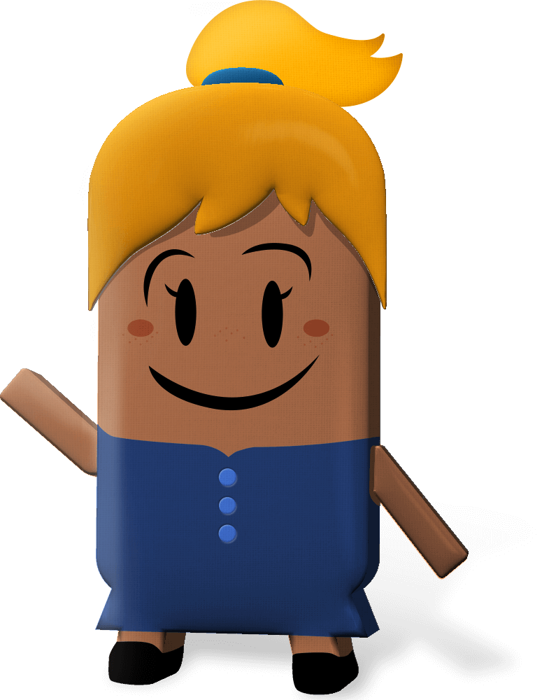
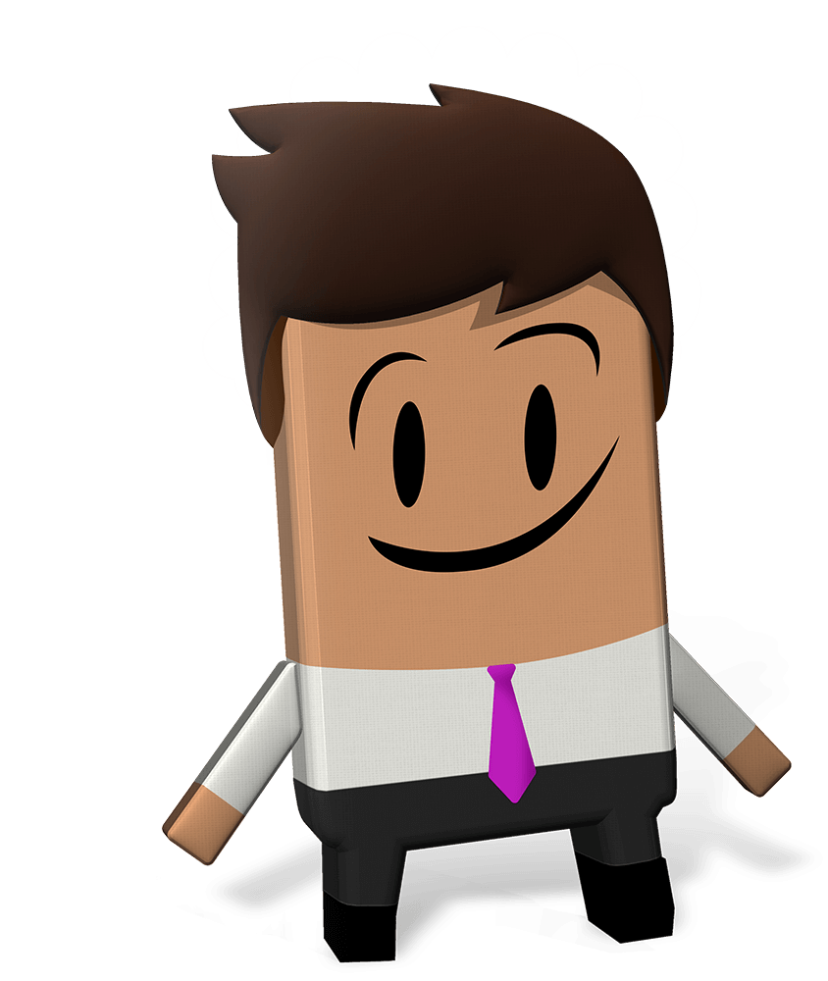
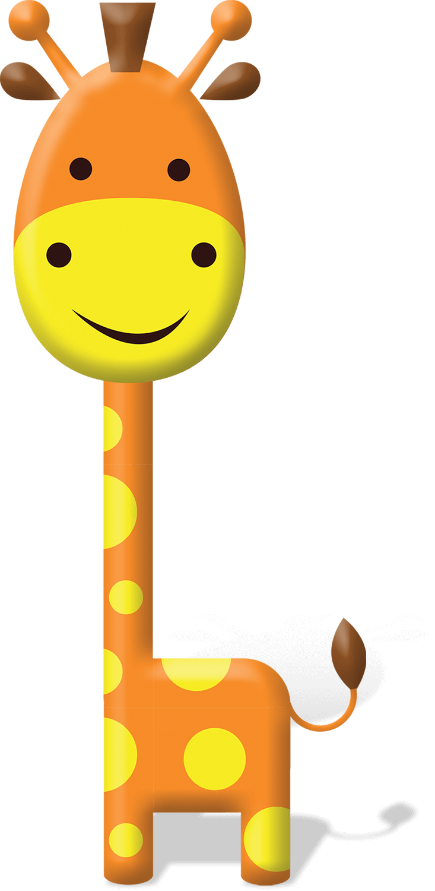
OUR WORLD IRISH AID AWARDS 2022
“WELLBEING FOR PEOPLE AND PLANET”
LESSON THREE
(3rd-4th class)
Notes:
Dear 3rd-4th class teacher,
Welcome to the third of four lessons for 3rd-4th class available for the 2022 Our World Irish Aid Awards.*
Irish Aid is the official overseas development cooperation programme of the Irish Government. The Government’s overseas development cooperation programme focuses on the realization of the United Nations Sustainable Development Goals with a specific emphasis on gender equality, reducing humanitarian need, supporting climate action, and strengthening governance in countries all around our world.
The Our World Irish Aid Awards were established in 2005 to encourage primary aged pupils to learn about how Ireland, through the Irish Aid programme, is working on these issues with international organizations (like the United Nations and the European Union), with governments, non-governmental organizations (NGOs), and with communities of people.
We are delighted that you have decided to take part in the Awards this year. You may have already engaged with the 2022 Our World Irish Aid Awards pupils’ magazine and/or Our World Irish Aid Awards lessons 1-2. We hope that your class find the activities and stories in the magazine and lessons engaging and fun and go on to generate and submit their own content for publication in our Global Goal Getters online magazines by kids, for kids.
EARLY SUBMISSIONS CLOSING DATE: Monday, 7TH February 2022
School entries received on or before 7th February 2022 are in with a chance to win a box of sustainable art materials.
FINAL CLOSING DATE: Friday, 8th April 2022
For support, more details and information about how to submit pupil’s work for the Global Goal Getters online magazine see www.ourworldirishaidawards.ie
All lessons are designed for approximately 45 minutes of class contact time. They are curriculum linked (see Slide 2) and classroom-ready, with minimal preparation required.
All that remains is for you to read through the teacher notes (available at the bottom of each slide when in ‘normal’ mode) and familiarise yourself with the animations (using ‘presenter’ mode) in advance of class. Depending on your version of PowerPoint you may be able to view the slide notes while presenting, but don’t worry, if not, you can access and print a pdf of the slide notes on our website, as a support for you during class.
We recognise that as their teacher, you know your own pupils very well. For this reason, the slides are fully editable so that, if necessary, you can tweak the lesson to best suit the context and needs of the children in your class. You may also find it helpful to consult our Good Practice Guidelines for teaching about poverty and development, also available on our website.
*If you have colleagues teaching 5th-6th class, you might like to let them know that lessons linked to the 5th-6th class curriculum are available on www.ourworldirishaidawards.ie
Every year we are blown away by the creativity and innovation of the teachers and pupils around the country who take part in the Awards. We can’t wait to see where you go with this year’s theme of ‘Wellbeing for people and planet’.
Remember to share your Our World Irish Aid Awards 2022 journey with us @Irish_Aid and @irishaidwards on Twitter, and @ourworldirishaidawards on Facebook using the hashtag #ourworldawards.
All the very best to you and your wonderful pupils.
The Our World Irish Aid Awards team

Slide 2
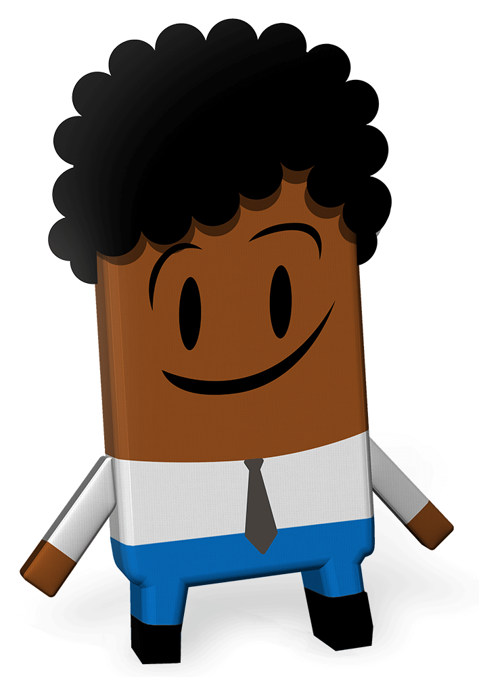
Curriculum Links
Curriculum area | Subject | Strand
SESE | Geography | Human environments
 | History | Continuity and change over time
SPHE |  | Myself and others Myself and the wider world
Primary language | English | Oral language Reading Writing
 | Gaeilge | Teanga ó Bhéal Léitheoireacht Scríbhneoireacht
Notes:
Teacher notes: Curriculum links (none)

Slide 3
Lesson Content
Activity No. | Activity name | Methodologies | Slide No.
Learning Intentions |  | Sharing the learning intentions | 4
1 | Looking back to move forward | Recap on learning about Irish Aid, the Global Goals and wellbeing for people and planet | 5
2 | Sierra Leone case study | Map | Photograph – I see, I think, I wonder | Photographs – to stimulate discussion about Covid-19 experiences in Sierra Leone and Ireland | 6-8
3 | School matters | Small group discussion and diamond ranking | whole class discussion in response to inspirational quote | 9-11
4 | Global Goal Getters | Thinking about our 2022 Our World Irish Aid Awards entries: input | 12
Reflection on learning |  | Checking in with the learning intentions | 13
In your own time |  | Education and the wellbeing of people and planet: inspirational poster | 14
Notes:
Teacher notes: Lesson Content (none)

Slide 4
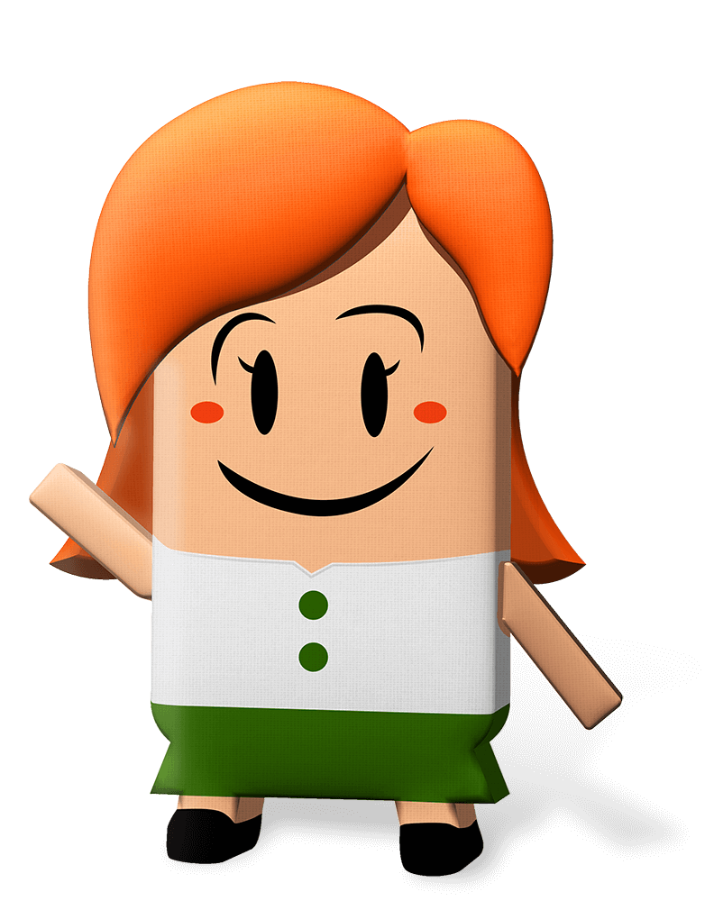
We are learning to…
examine some of the Covid-19 experiences of school children in Sierra Leone and Ireland
discuss why school matters
consider the idea that education is the key to making the Global Goals happen
Notes:
Teacher notes: Learning intentions (3 consecutive animations at * Click)
Sensitivity note: As their teacher, you know your own pupils well. Please feel free to edit the learning intentions and the activities in this lesson to best suit the context and needs of the children in your class.
See also our Good Practice Guidelines for teaching about poverty and development in the lesson plan section of our website: www.ourworldirishaidawards.ie
Lesson Three is based on a case study of Irish Aid supported work in Sierra Leone, a country in West Africa.
Irish Aid is part of the Irish Government. Irish Aid works together with other governments, with different groups (non-governmental organizations (NGOs) or charities), and with communities in countries all around our world.
Depending on your class, you might like to share that they will be entering some of their work to the Our World Irish Aid Awards. The Our World Irish Aid Awards are a way for children and young people, like the pupils in your class, to learn about what Irish Aid does, to learn about the Global Goals, and to think about ways that they can work for the wellbeing of people and planet.
Ask for volunteers to read the three learning intentions for Lesson Three.
* Click to animate in the three learning intentions for this lesson, one after another

Slide 5
Activity 1
Insert feedback here
Slide 1 of 1 | Looking back to move forward
Notes:
Teacher notes: Activity 1/Slide 1 of 1 (Looking back to move forward) (no animation)
The theme of the 2022 Our World Irish Aid Awards is ‘Wellbeing for people and planet’.
Invite pupils to talk about their engagement with the Our World Irish Aid Awards activities so far using the following prompt questions:
What are the United Nations Global Goals for Sustainable Development?
What is Irish Aid?
Where does Irish Aid work?
What are some of the ways that Irish Aid supports wellbeing for people and the wellbeing of our planet?
Record pupil responses on the book on Slide 5.
[NB: to insert words in the text box on the book, you need to be in ‘normal’ rather than ‘presenter’ mode. Click on ‘Insert feedback here’ and replace the instructional text with responses from your pupils.]

Slide 6
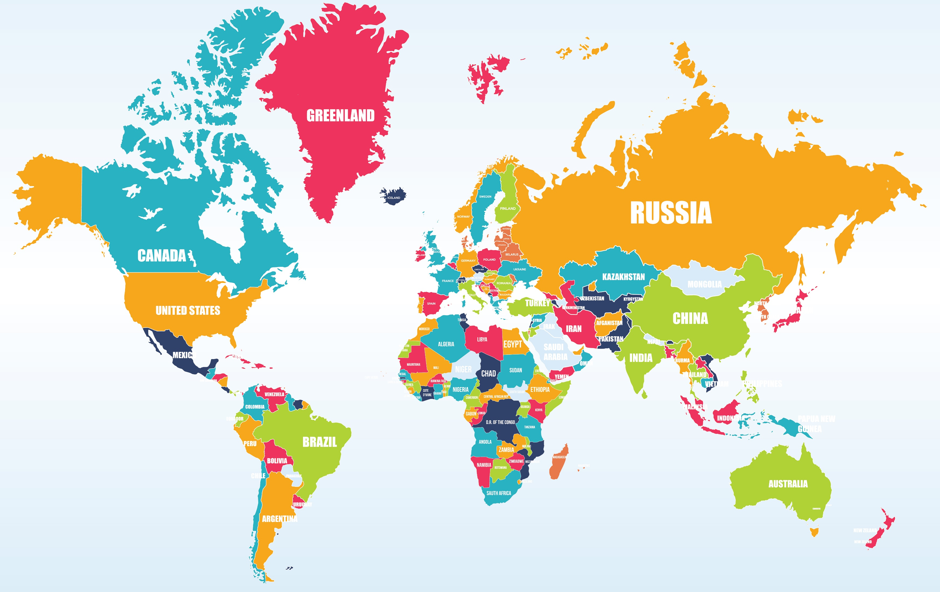
Activity 2
Ireland
Sierra Leone
Slide 1 of 3 | Sierra Leone Case Study
Notes:
Teacher notes: Activity 2/Slide 1 of 3 (Sierra Leone case study) (2 animations at * Click)
Can you locate Ireland on the map of our world?
* Click to animate the arrow pointing to Ireland
Does anyone know anything about a country called Sierra Leone which is located West Africa?
* Click to animate the arrow pointing to Sierra Leone
Sierra Leone is known as the ‘little jewel’ of West Africa because there are lots of different cultures, religions and nationalities amongst the people who live there. Sierra Leone is one of the countries where Irish Aid works for the wellbeing of people and planet.

Slide 7
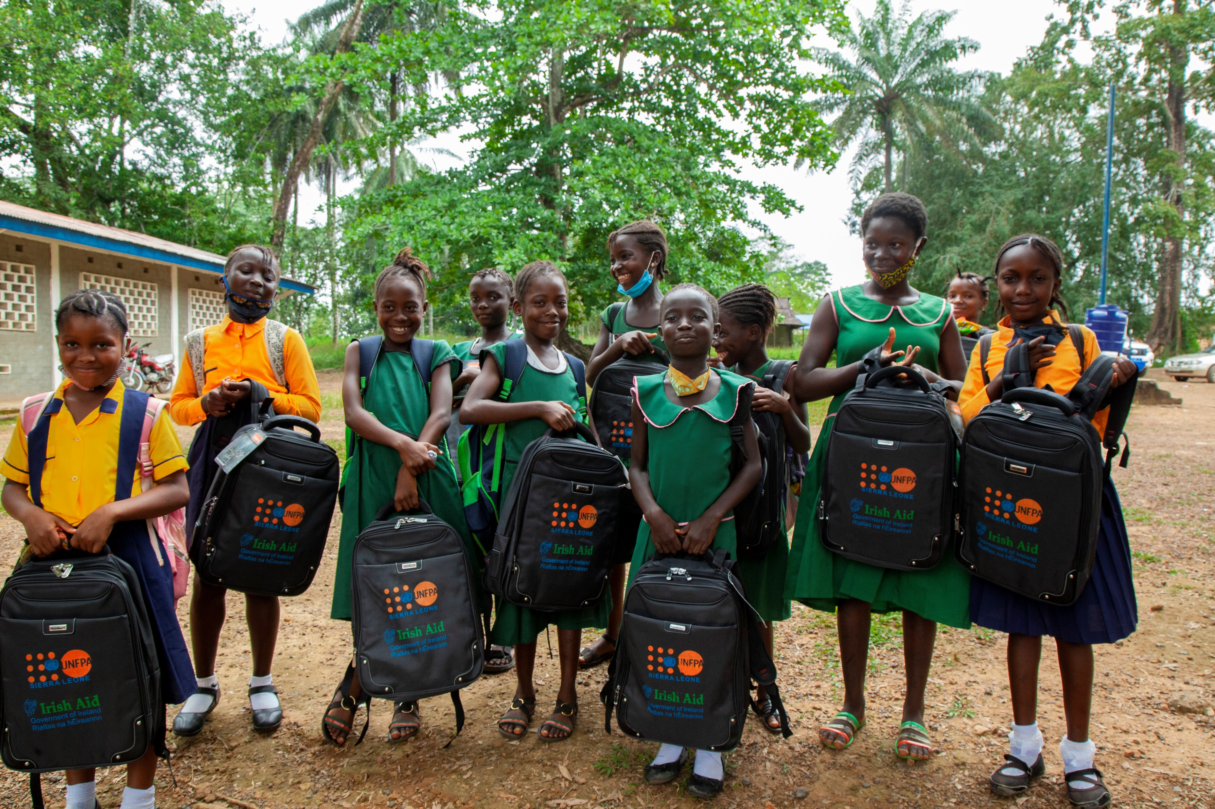
Activity 2
I see
I think
I wonder
Slide 2 of 3 | Sierra Leone case study
Notes:
Teacher notes: Activity 2/Slide 2 of 3 (Sierra Leone case study) (no animation)
Take out your copy/a piece of paper and something to write.
* Click to animate in the photograph
This is a photograph of schoolgirls in the Pujehun district of Sierra Leone.
Take a minute to look at the photograph in silence.
* Click to animate in the ‘I see’ prompt
In your copy/on a piece of paper write what you see when you look at this photograph.
* Click to animate in the ‘I think’ prompt
Now write a few things that the photograph makes you think about – this could be something that you have noticed or a thought that just came into your head.
* Click to animate in the ‘I wonder’ prompt
Finally, write anything that you are left wondering about – maybe you have questions you would like to ask the people in the photograph or the photographer, or maybe there is something that you would like to know about what happened before or after the photograph was taken?
Take feedback from a selection of pupils about their ‘I see, I think, I wonder’ responses.
________________________________________________________
Photograph ©UNFPA Sierra Leone/2020/John Sesay

Slide 8
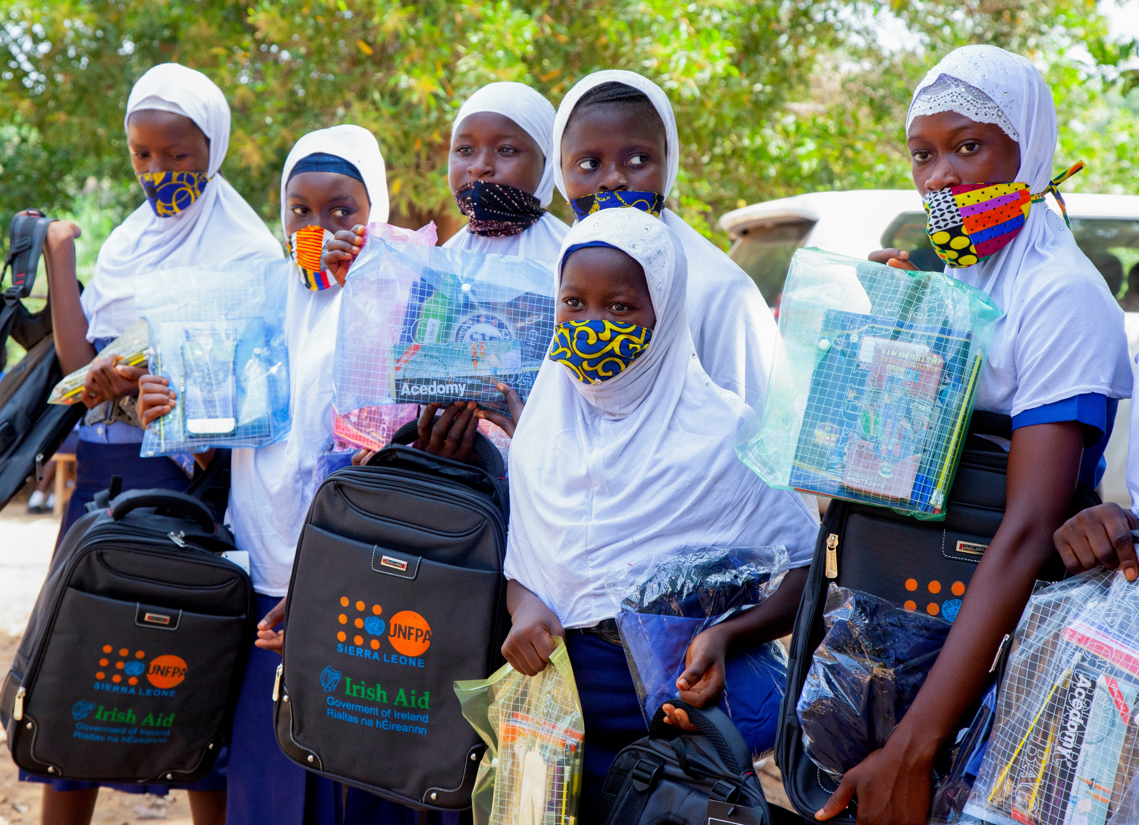
Activity 2
Slide 3 of 3 | Sierra Leone case study
Notes:
Teacher notes: Activity 3/Slide 3 of 3 (Sierra Leone case study) (no animation)
This is a photograph of schoolgirls in the Kambia district of Sierra Leone.
Take a minute to look at the photograph in silence.
* Click to animate in a thumbnail of the photograph from Slide 7
Can you see any similarities between the two photographs?
If no one mentions that the girls in both photographs are holding the same bags, point this out.
Look closely at the bags that the girls in the photograph are holding. What, if anything, do you notice?
If no one mentions that the bags have two logos, one is the logo for the United Nations Population Fund (UNFPA) and the other is the logo for Irish Aid, point this out.
* Click to animate in the two logos onto Slide 7
Both pictures were taken by a photographer working for the United Nations Population Fund (UNFPA). The children in the photographs are Sierra Leonian girls starting back in school in October 2020 when schools reopened after the Covid-19 closures.
In Sierra Leone schools were shut for 14 weeks because of Covid-19 and in Ireland schools were forced to close for a total of 24 weeks. Children and young people in both Sierra Leone and Ireland (including everyone sitting in the class) were affected by these closures.
When schools in Sierra Leone closed, Irish Aid gave funding (money) to the United Nations Population Fund (UNFPA) to make lessons which were broadcast on radio. Irish Aid also supported UNFPA and the Women in Crisis Movement (a local Sierra Leonian NGO or charity) to give 2,000 radios to girls to make sure that they could listen to the radio lessons.
What technology did you use to help you learn during Covid-19 school closures? [prompts: devices like mobile phones, laptops or computers, applications like Zoom, Padlet or seesaw, TV etc]
When schools in Sierra Leone reopened, Irish Aid again supported UNFPA and the Women in Crisis Movement to help families who were finding it difficult to cover the cost of getting their children back to school. Back-to-school kits were given to 1,000 primary and secondary school girls. Each kit was made up of a school uniform, a backpack, five schoolbooks, a mathematical set, pencils, pens, and a plastic folder.
What, if anything, do you need to go back to school after a break, like when schools reopened after Covid-19 closures or at the beginning of this school year?
[prompts: new uniform, stationary/books, school bag, lunch box, water bottle etc]
_______________________________________________________________
Photograph ©UNFPA Sierra Leone/2020/John Sesay

Slide 9
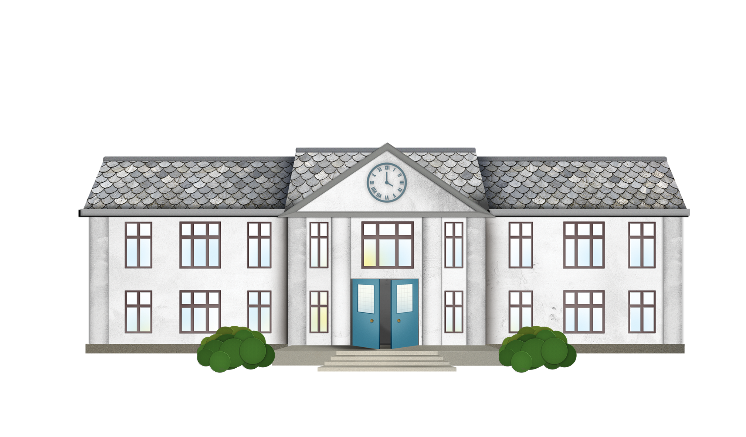
Activity 3
Insert feedback here
Slide 1 of 3 | School matters
Notes:
Teacher notes: Activity 3/Slide 1 of 3 (School matters) (no animation)
Divide pupils into small groups.
In your group, take a few minutes to talk about why school matters/is important.
Record pupil feedback in the text box provided on Slide 9.
[NB: to insert words in the text box, you will need to be in ‘normal’ rather than ‘presenter’ mode. Click on ‘Insert feedback here’ and replace this instructional text with responses from your pupils.]
As you know, the theme of the 2022 Our World Irish Aid Award is ‘Wellbeing for people and planet’. People experience wellbeing (being well) when we feel healthy and happy and have positive connections to people and places, near and far.
Think about the role/importance of school and learning in making sure that you and others are well and for making sure that we look after our planet. Do you want to add anything to what is already on the board?

Slide 10
Activity 3
Rank the reasons why school matters in order of importance,
where 1 is the most important and 5 is the least important.
1
2
2
3
3
3
4
4
5
Slide 2 of 3 | School matters
Notes:
Teacher notes: Activity 3/Slide 2 of 3 (School matters) (no animation)
Invite each group to take a sheet of paper and cut out nine rectangles of a similar size.
Each group needs to write nine reasons why school matters – one reason on each of their nine rectangles. Then, diamond-rank your nine reasons in order of importance, where 1 is the most important and 5 is the least important. You can move your rectangles around as you discuss where things might be ranked.
Ask a selection of groups to explain their decisions and identify any interesting discussions or issues that arose during the ranking activity.

Slide 11
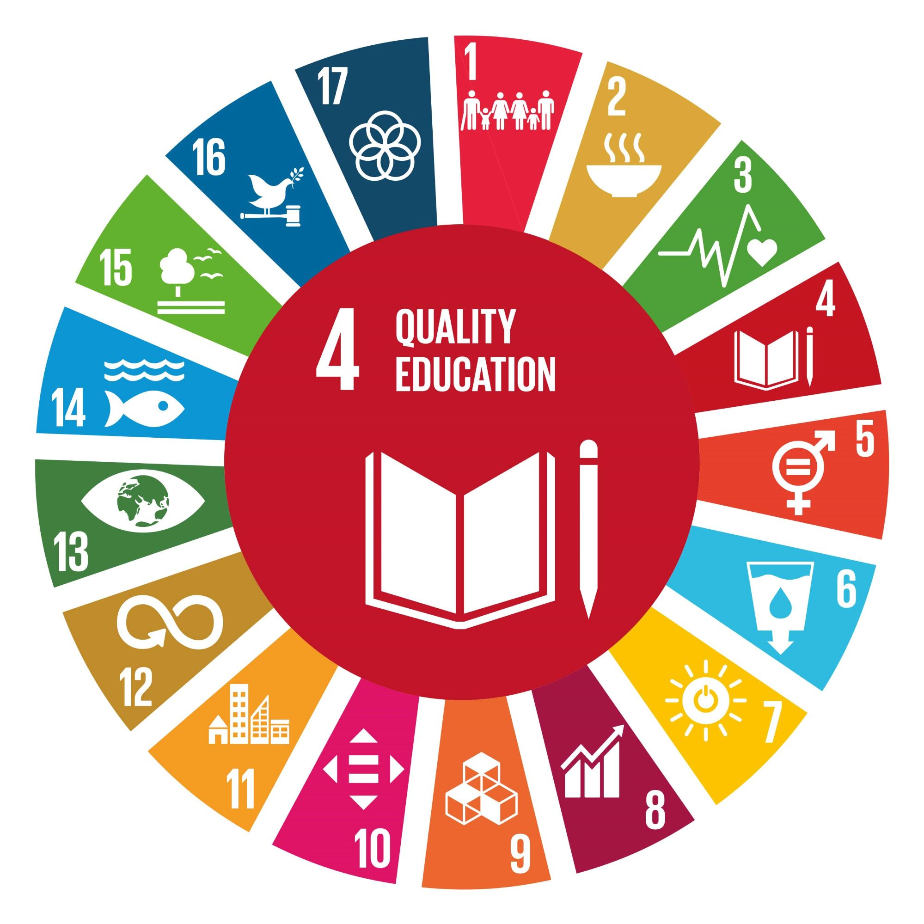
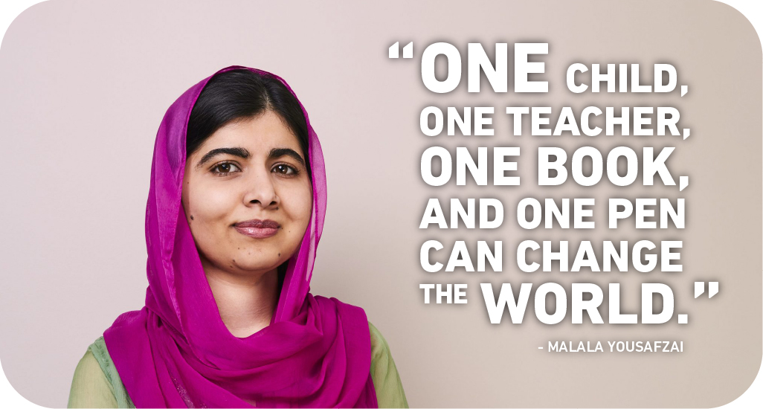
Activity 3
Slide 3 of 3 | School matters
Notes:
Teacher notes: Activity 3/Slide 3 of 3 (School matters) (no animation)
Has anyone ever heard of Malala Yousafzai? What do you know about Malala? (see short biography below)
NB: If you have already completed Lesson One, then your class may remember something of Malala Yousafrzai.
Malala is an activist, or someone who takes action to bring about positive change in our world. Malala focuses on helping girls all over our world go to and stay in school.
Read the quote from Malala (Slide 11) aloud.
What do you think that Malala is saying?
This inspirational quote from Malala fits with the view held by lots of people in our world that going to school and getting a good (quality) education is the key to making the Global Goals happen.
What do you think about the view that Global Goal 4 (Quality Education) is the key to making the Global Goals happen?
Malala Yousafzai – short biography
Malala Yousafzai was born in the Swat Valley in Pakistan, in 1997. When she was younger, Malala’s basic right to education was threatened when the Taliban (a militant Islamic group) took control in the Swat Valley. Because of this, Malala is an activist, who is known for speaking out about the need to support the education of girls and women. In 2014, Malala was awarded the Nobel Peace Prize. The Malala Fund is a charity run by Malala which supports girls all over our world to go to and stay in school.

Slide 12
Activity 4
Here are some of the fantastic examples of pupils’ work included in 2021 Global Goal Getters magazines.
See https://www.ourworldirishaidawards.ie/global-goals-archive/ for more great examples.
Slide 1 of 1 | GLOBAL GOAL GETTERS
Notes:
Teacher notes: Activity 4/Slide 1 of 1 (Global Goal Getters) (3 consecutive animations at * Click)
We are going to take part in the Our World Irish Aid Awards.
* Click to animate in four different examples of Award entries received in 2021
Read the narrative provided for each entry and comment on the format (Carrabane NS = poster; Dromclough NS = artwork; Ghaelscoil Chuainin = artwork; Scoil Ide = animation) and the focus of these four entries (Carrabane NS = Irish Aid support for refugees in Uganda, based on the 2021 case study; Dromclough NS = Partnership for the Goals, the 2021 Our World Awards theme; Ghaelscoil Chuainin and Scoil Ide = Global Goals for Sustainable Development).
The format for Awards entries is wide open; we can submit video, audio, written, or multimedia entries. This means we can enter short stories, poems, surveys, performances, drawings etc.
Our entries must be about the 2022 Awards theme of ‘Wellbeing for people and planet’, the Global Goals generally and/or the work of Irish Aid in different countries.
Another great thing about the Awards is that we can take as much or as little time as we like to create our entry and we can enter more than once!
Everyone who enters will get a certificate of participation.
Selected entries will feature in one of two, Global Goal Getters online magazines, by kids, for kids on www.ourworldirishaidaward.ie.
The best entries overall will appear in our Global Goal Getters Annual published in June 2022, available online and as an insert in a national newspaper. These teachers/pupils will also be invited to attend a National Awards ceremony in June 2022. Each winner will receive copies of the Global Goal Getters Annual and a plaque or trophy for their school.
For more support, see Lesson Four on our website and check out the fantastic entries featured in the last year’s Global Goal Getters: https://www.ourworldirishaidawards.ie/global-goals-archive/
EARLY SUBMISSIONS CLOSING DATE: Monday, 7TH February 2022
School entries received on or before 7th February 2022 are in with a chance to win a box of sustainable art materials.
FINAL CLOSING DATE: Friday, 8th April 2022
Please complete an Entry Form (available in your teacher pack or for download from our website) and submit your work via email: ourworld@realnation.ie or by post to: Our World Irish Aid Awards
Real Nation
24 Arran Quay Dublin 7
D07 W620 Further information is available: www.ourworldirishaidaward.ie You can also email or ring our project office if you have any queries about the Our World Irish Aid Awards or submission details E: ourworld@realnation.ie / P: 01 522 4834
We would love to hear about how you are getting on with the curriculum materials and Award entries. You can share your Our World Irish Aid Awards 2022 journey with us @Irish_Aid and @irishaidwards on Twitter, and @ourworldirishaidawards on Facebook using the hashtag #ourworldawards
DID YOU KNOW?
Additional Irish Aid primary resources are available: https://www.irishaid.ie/teaching-and-learning/primary/

Slide 13
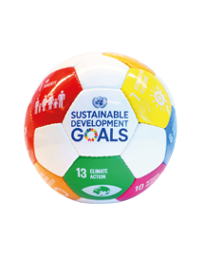
We have learned to…
examine some of the Covid-19 experiences of school children in Sierra Leone and Ireland
discuss why school matters
consider the idea that education is the key to making the Global Goals happen
WELL DONE CLASS!
You’re all amazing
Global Goal Getters!
Slide 1 of 1 | Reflection on learning
Notes:
Teacher notes: Slide 1 of 1: Reflection on learning (4 animations * Click – 3 come in one after another on the 2nd Click)
Let’s take a few minutes to think about (reflect) on what we have learned in this lesson.
Imagine you are playing basketball.
As each of the things you were learning in this lesson appear on the board, you should mime:
Shooting and scoring the winning basket in the match – if you are happy that you have learned what is on the board
* Click to animate the ball dropping into the net to demonstrate what you mean
Dribbling the ball – if you still need a little support from either myself or your classmates to be able to say that you have learned what is on the board
* Click to animate each of the 3 learning intentions for this lesson in separately, reading each aloud as they appear.
Observe pupils to see who might need some extra support.
You have all done an amazing job and are all fantastic Global Goal Getters.
Don’t forget to check out www.ourworldirishaidaward.ie for information about how to get your pupils work published in one of our 2022 Goal Getters online magazines, by kids, for kids!

Slide 14
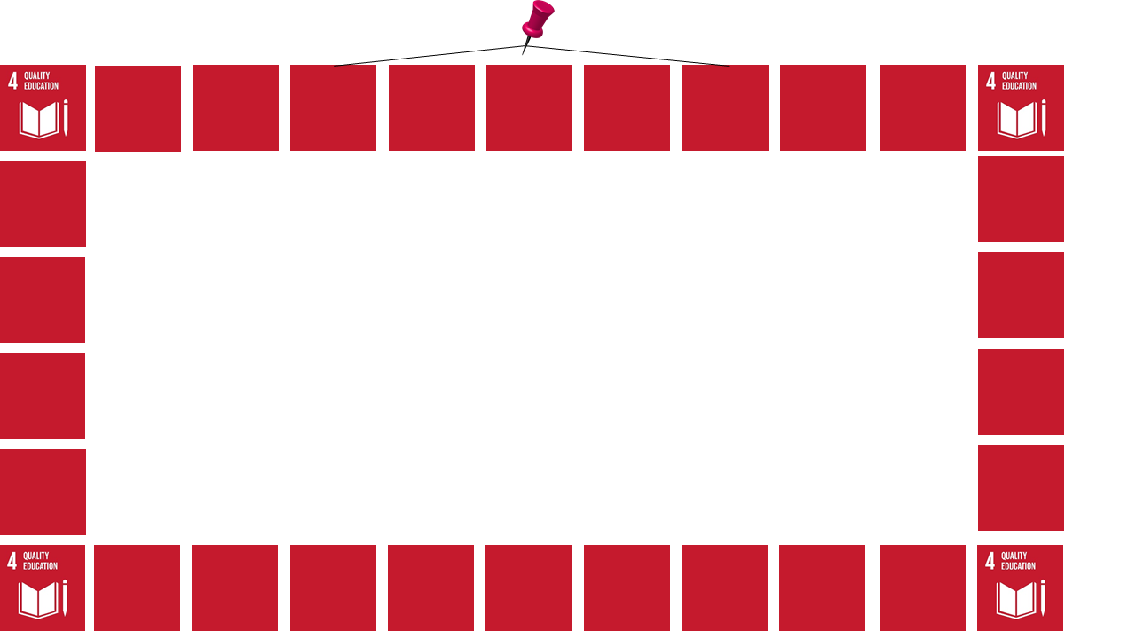
In your own time…
Come up with a memorable quote about why school matters for the wellbeing of people and planet.
Find or draw an image to match your quote.
Use your image and quote to make an inspirational poster.
Notes:
Teacher notes: (In your own time: Inspirational poster) (no animations)
Design an inspirational poster about why education matters for the wellbeing or people and planet.
come up with a memorable quote (like Malala did - Slide 11)
use/adapt or draw an image to match your quote
Encourage pupils who create an inspirational poster to enter it for the Awards. We would love to see these and any other work they do, and they could be in with a change to be featured in the 2022 Global Goal Getters magazines, by kids, for kids.
See entry details in the Slide notes on Slide 12. Further information is available: www.ourworldirishaidaward.ie

