Slide 1
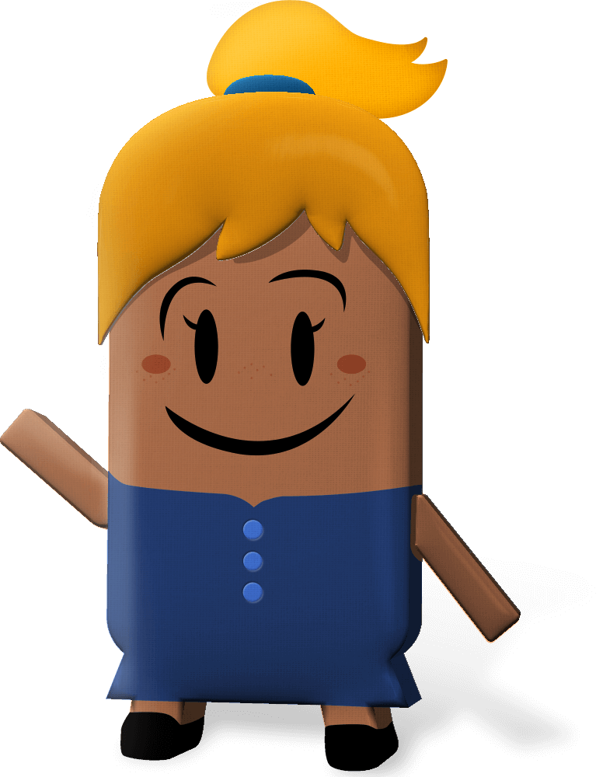
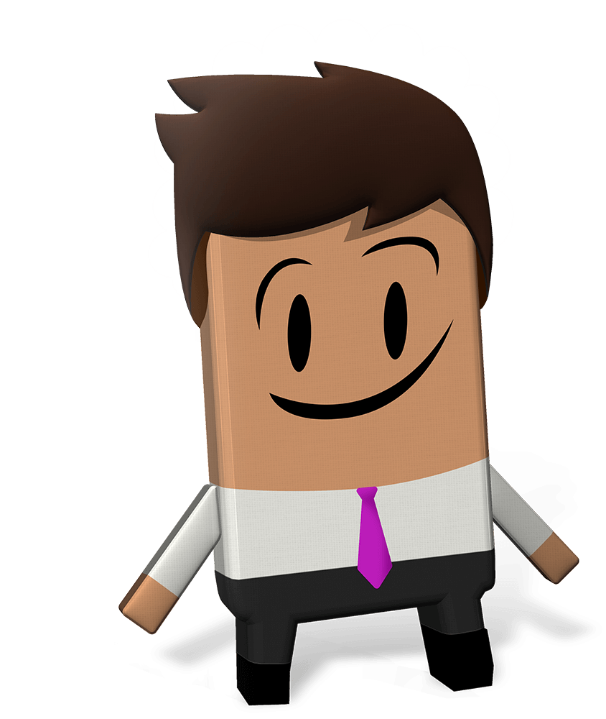
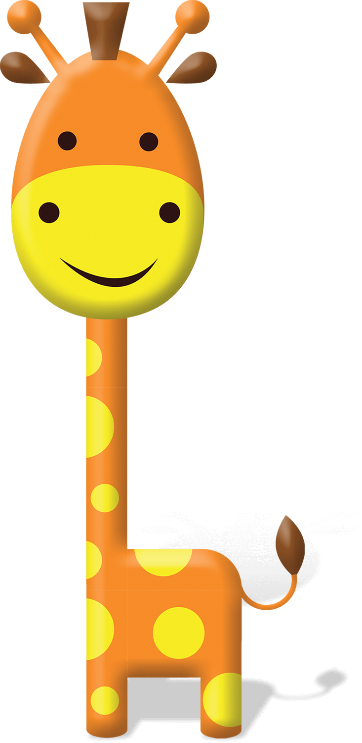
OUR WORLD IRISH AID AWARDS 2022
“Wellbeing for people and planet”
LESSON TWO
(3rd-4th class)
Notes:
Dear 3rd-4th class teacher,
Welcome to the second of four lessons for 3rd-4th class available for the 2022 Our World Irish Aid Awards.*
Irish Aid is the official overseas development cooperation programme of the Irish Government. The Government’s overseas development cooperation programme focuses on the realization of the United Nations Sustainable Development Goals with a specific emphasis on gender equality, reducing humanitarian need, supporting climate action, and strengthening governance in countries all around our world.
The Our World Irish Aid Awards were established in 2005 to encourage primary aged pupils to learn about how Ireland, through the Irish Aid programme, is working on these issues with international organizations (like the United Nations and the European Union), with governments, non-governmental organizations (NGOs), and with communities of people.
We are delighted that you have decided to take part in the Awards this year. You may have already engaged with the 2022 Our World Irish Aid Awards pupils’ magazine and/or the first of four Our World Irish Aid Awards lessons. We hope that your class finds the activities and stories in the magazine and lessons engaging and fun and go on to generate and submit their own content for publication in our Global Goal Getters online magazines by kids, for kids.
EARLY SUBMISSIONS CLOSING DATE: Monday, 7TH February 2022
School entries received on or before 7th February 2022 are in with a chance to win a box of sustainable art materials.
FINAL CLOSING DATE: Friday, 8th April 2022
For support, more details and information about how to submit pupil’s work for the Global Goal Getters online magazine see www.ourworldirishaidawards.ie
All lessons are designed for approximately 45 minutes of class contact time. They are curriculum linked (see Slide 2) and classroom-ready, with minimal preparation required.
All that remains is for you to read through the teacher notes (available at the bottom of each slide when in ‘normal’ mode) and familiarise yourself with the animations (using ‘presenter’ mode) in advance of class. Depending on your version of PowerPoint you may be able to view the slide notes while presenting, but don’t worry, if not, you can access and print a pdf of the slide notes as a support for you during class on our website.
We recognise that as their teacher, you know your own pupils very well. For this reason, the slides are fully editable so that, if necessary, you can tweak the lesson to best suit the context and needs of the children in your class. You may also find it helpful to consult our Good Practice Guidelines for teaching about poverty and development, available on our website.
*If you have colleagues teaching 5th-6th class, you might like to let them know that lessons linked to the 5th-6th class curriculum are available on www.ourworldirishaidawards.ie
Every year we are blown away by the creativity and innovation of the teachers and pupils around the country who take part in the Awards. We can’t wait to see where you go with this year’s theme of ‘Wellbeing for people and planet’.
Remember to share your Our World Irish Aid Awards 2022 journey with us @Irish_Aid / @ourworldirishaidawards on social media using the hashtag #ourworldawards.
All the very best to you and your wonderful pupils.
The Our World Irish Aid Awards team

Slide 2
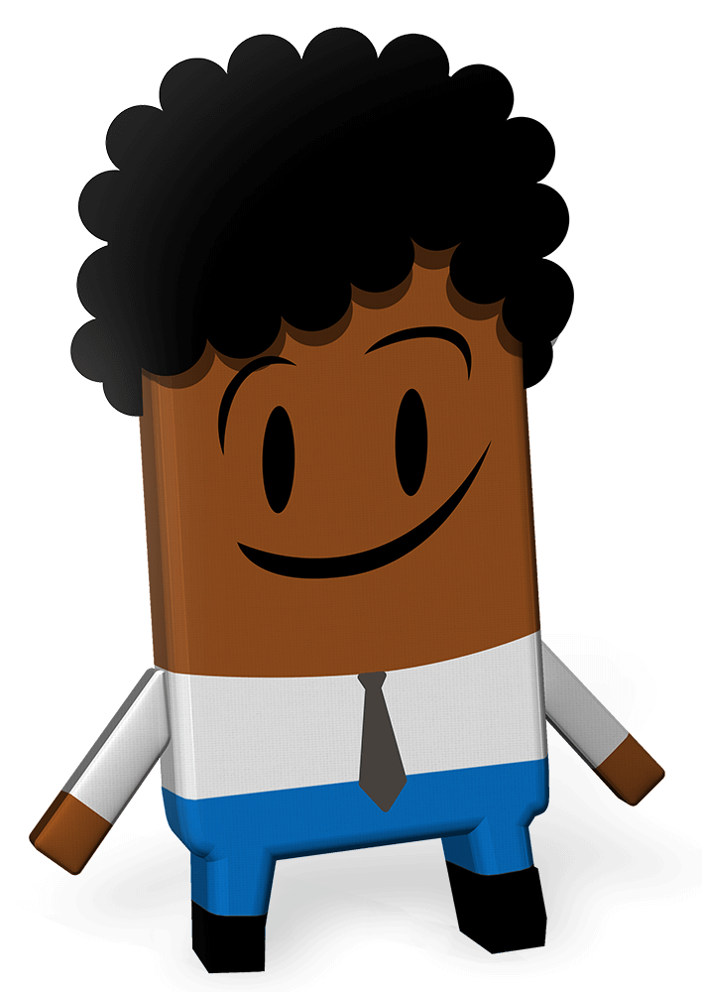
Curriculum Links
Curriculum area | Subject | Strand
SESE | Geography | Human environments
 | History | Continuity and change over time
SPHE |  | Myself and others Myself and the wider world
Primary language | English | Oral language Reading Writing
 | Gaeilge | Teanga ó Bhéal Léitheoireacht Scríbhneoireacht
Notes:
Teacher notes: Curriculum links (none)

Slide 3
Lesson Content
Activity No. | Activity name | Methodologies | Slide No.
Learning Intentions |  | Sharing the learning intentions | 4
1 | Making a difference | Irish Aid: input | Story - whole class discussion using literacy prompts | 5-7
2 | Stories of progress | Q&A with the focus country information | 8-12
3 | Global Goal Getters | Thinking about our 2022 Our World Irish Aid Awards entries: input | 13
Reflection on learning |  | Checking in with the learning intentions | 14
In your own time… | In your own time… | Online Global Goals Spinner game for pupils to do in their own time | 15
Notes:
Teacher notes: Lesson content (no animations)

Slide 4
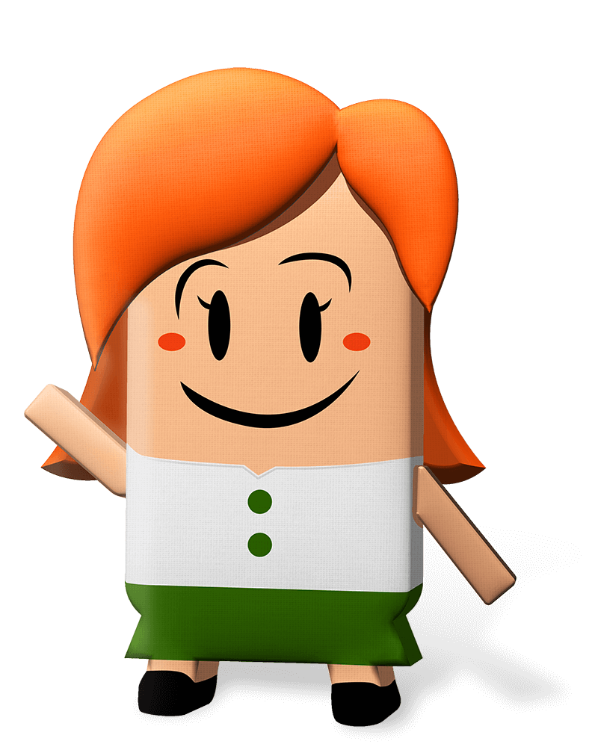
We are learning to…
identify what Irish Aid is and does
discuss the links between Irish Aid work around our world and the Global Goals
reflect on the importance of making a difference
Notes:
Teacher notes: Learning intentions (3 consecutive animations at * Click)
Sensitivity note: As their teacher, you know your own pupils well. Please feel free to edit the learning intentions and the activities in this lesson to best suit the context and needs of the children in your class.
See also our Good Practice Guidelines for teaching about Poverty and development in the lesson plan section of our website: www.ourworldirishaidawards.ie
This lesson (Two) is all about the work that Irish Aid does in different countries for the wellbeing of all people and our planet.
Irish Aid is part of the Irish Government. Irish Aid works together with other governments, with different groups (non-governmental organizations (NGOs) or charities), and with communities in countries all around our world.
Depending on your class, you might like to share that they will be entering some of their work to the Our World Irish Aid Awards. The Our World Irish Aid Awards are a way for children and young people, like the pupils in your class, to learn about what Irish Aid does, to learn about the Global Goals, and to think about ways that they can work for the wellbeing of people and planet.
Ask for volunteers to read the three learning intentions for Lesson Two.
* Click to animate in the three learning intentions for this lesson, one after another

Slide 5
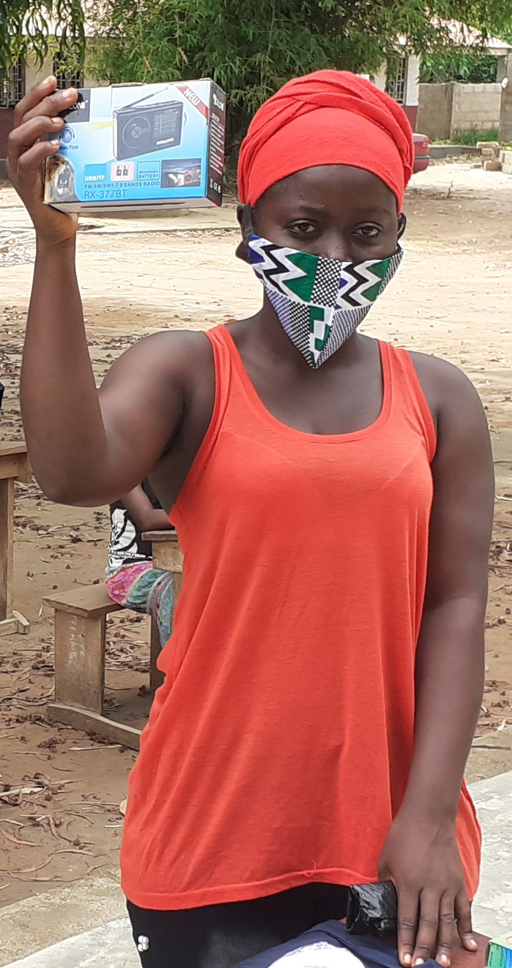
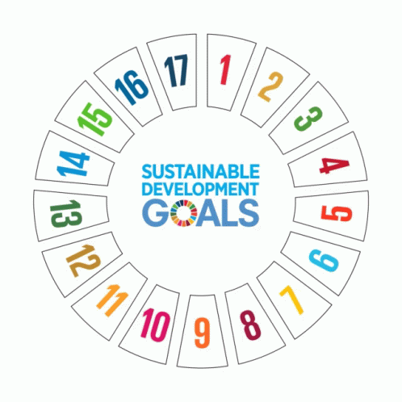
Activity 1
Slide 1 of 3 | Making a difference
Notes:
Teacher notes: Activity 1/Slide 1 of 3 (Making a difference: input) (2 animations at * Click)
The Government of Ireland has a programme for overseas development cooperation called Irish Aid. Overseas development cooperation is a term that can be difficult to understand. It means a programme that works to end world hunger and poverty and tackle climate change on behalf of the people of Ireland. For this reason, it is important that we know what Irish Aid does to try to make our world a better place. Irish Aid works with other governments, with different groups (NGOs or charities), and with communities, in countries all over our world, to try to make the Global Goals happen; so that everyone everywhere, now and in the future, can live on a healthy planet and in a better world.
* Click to animate in the photograph of the Women in Crisis Movement staff member
This photo is of a lady who works with a non-governmental organization (NGO or charity) in Sierra Leone called the Women in Crisis Movement. In 2020, Irish Aid supported the United Nations Population Fund (UNFPA) and the Women in Crisis Movement to give radios to girls from disadvantaged families so that they could listen to their lessons on the radio when schools closed because of Covid-19. This is an example of the type of work that Irish Aid supports in different countries around our world.
* Click to animate in the 17 Global Goals gif
Which Global Goals can be linked to the example of Irish Aid supported work in Sierra Leone? (possible answers: Goal 4: Quality education, Goal 5: Gender equality, Goal 10: Reduced inequalities, Goal 17: Partnership for the Goals)
The 17 Global Goals are universal. This means that they are for everyone and especially the people in our world who are most at risk – those who do not have enough good food or clean water to live well or people who cannot afford to send their children to school or get medical help when they need it.
The fact that the Goals are universal means that we all have a responsibility to do something about the Global Goals. This applies to individual people, like you and me, but also to countries. Countries that have more money and resources, like Ireland, should support countries with less, for example, Sierra Leone, so that the Global Goals happen. This is what Irish Aid, on behalf of the people of Ireland, is trying to do.
As we all learn to live with COVID-19, it’s more important than ever that we think about the wellbeing of people and planet and work to make the Global Goals happen by looking after ourselves, each other, and our world.
For more information about Irish Aid see: www.irishaid.ie

Slide 6
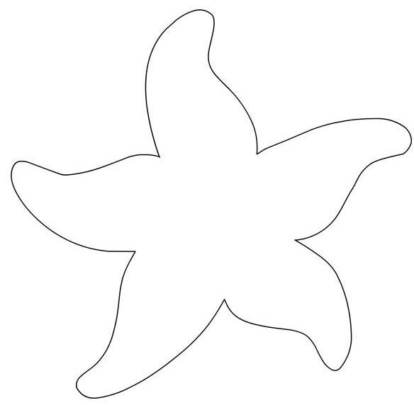
Activity 1
One day a man was walking along the beach, when he noticed a small child picking up and throwing something into the ocean.
Approaching the child, he said, ‘Excuse me, I’m curious to know what you are doing’.
The child replied, ‘Throwing starfish back into the ocean. The surf is up and the tide is going out. If I don’t throw them back, they’ll die.’
The man laughed and said, ‘Don’t you realise there are miles and miles of beach and hundreds of starfish? You can’t make any difference!’
After listening politely, the child bent down, picked up another starfish, and threw it into the water.
Then, smiling at the man, the child said, ‘I made a difference to that one.’
Adapted from the original Starfish story by Loren Eisley
Slide 2 of 3 | Making a difference
Notes:
Teacher notes: Activity 1/Slide 2 of 3 (Making a difference: story) (no animation)
Invite volunteers to read the Starfish Story.
Discuss the story using the following prompt questions:
Who are the characters in the story?
What is the setting?
What is the problem?
What happens to the characters?
What is the climax or the most exciting point of the story?
How is the problem solved?
How have the characters changed?
Like the child in the story, Ireland is just one small country, but we have a really good reputation all around the world as a country that works for the wellbeing of people and our planet through Irish Aid, the Government of Ireland’s programme for overseas development cooperation.

Slide 7
Activity 1
Slide 3 of 3 | Making a difference
Notes:
Teacher notes: Activity 1/Slide 2 of 3 (Making a difference) (no animation)
Draw a starfish with five arms in your copy/on a piece of paper.
Take a minute to recall what you know about Irish Aid.
Write things that you know about Irish Aid on the arms of your starfish.
Share what you have written with a friend, then write down any additional things about Irish Aid on your starfish that your friend had and you did not.
Depending on your class, you might like to use the following prompt questions as a support:
Before these lessons, where/have you heard of Irish Aid?
What do people that work in Irish Aid do?
Where in the world does Irish Aid work? Can you name any of the countries?
What other groups or organizations does Irish Aid work with?
Keep your starfish, as you will need it towards the end of this lesson (see Slide 12/notes).

Slide 8
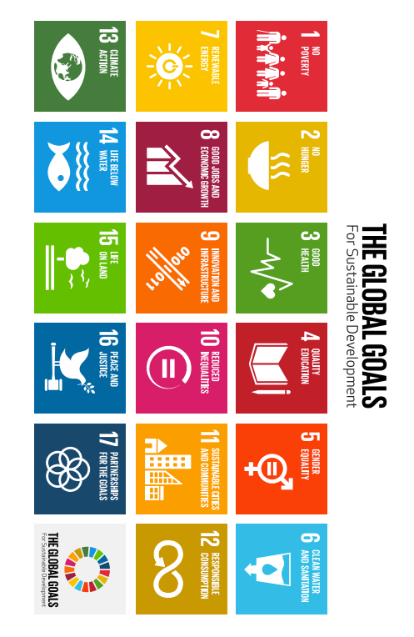
Activity 2
STORIES OF PROGRESS
Slide 1 of 5 | Stories of progress
Notes:
Teacher notes: Activity 2/Slide 1 of 5 (Stories of progress) (no animation)
Sensitivity note: If you have pupils who are from or have family from/in one of the countries in Activity 2, you might like to firstly check in with them, to see whether they would like to contribute any thoughts as you run through Slides 9-12– see our Good Practice Guidelines for teaching about poverty and development in the lesson plan section of our website: www.ourworldirishaidawards.ie
Let’s find out more about Irish Aid supported work to progress the Global Goals in countries all over our world.
NB: The information on Slides 9-12 will support your pupils to test what they have learned about the Global Goals and the work of Irish Aid by competing against the clock in our online Global Goal Spinner game, available: https://globalspinner.ourworldirishaidawards.ie/#/game/title

Slide 9
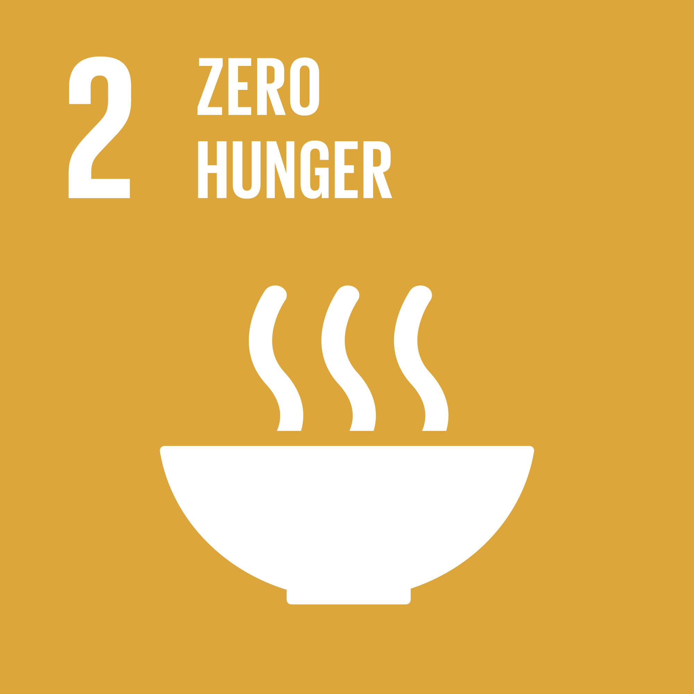
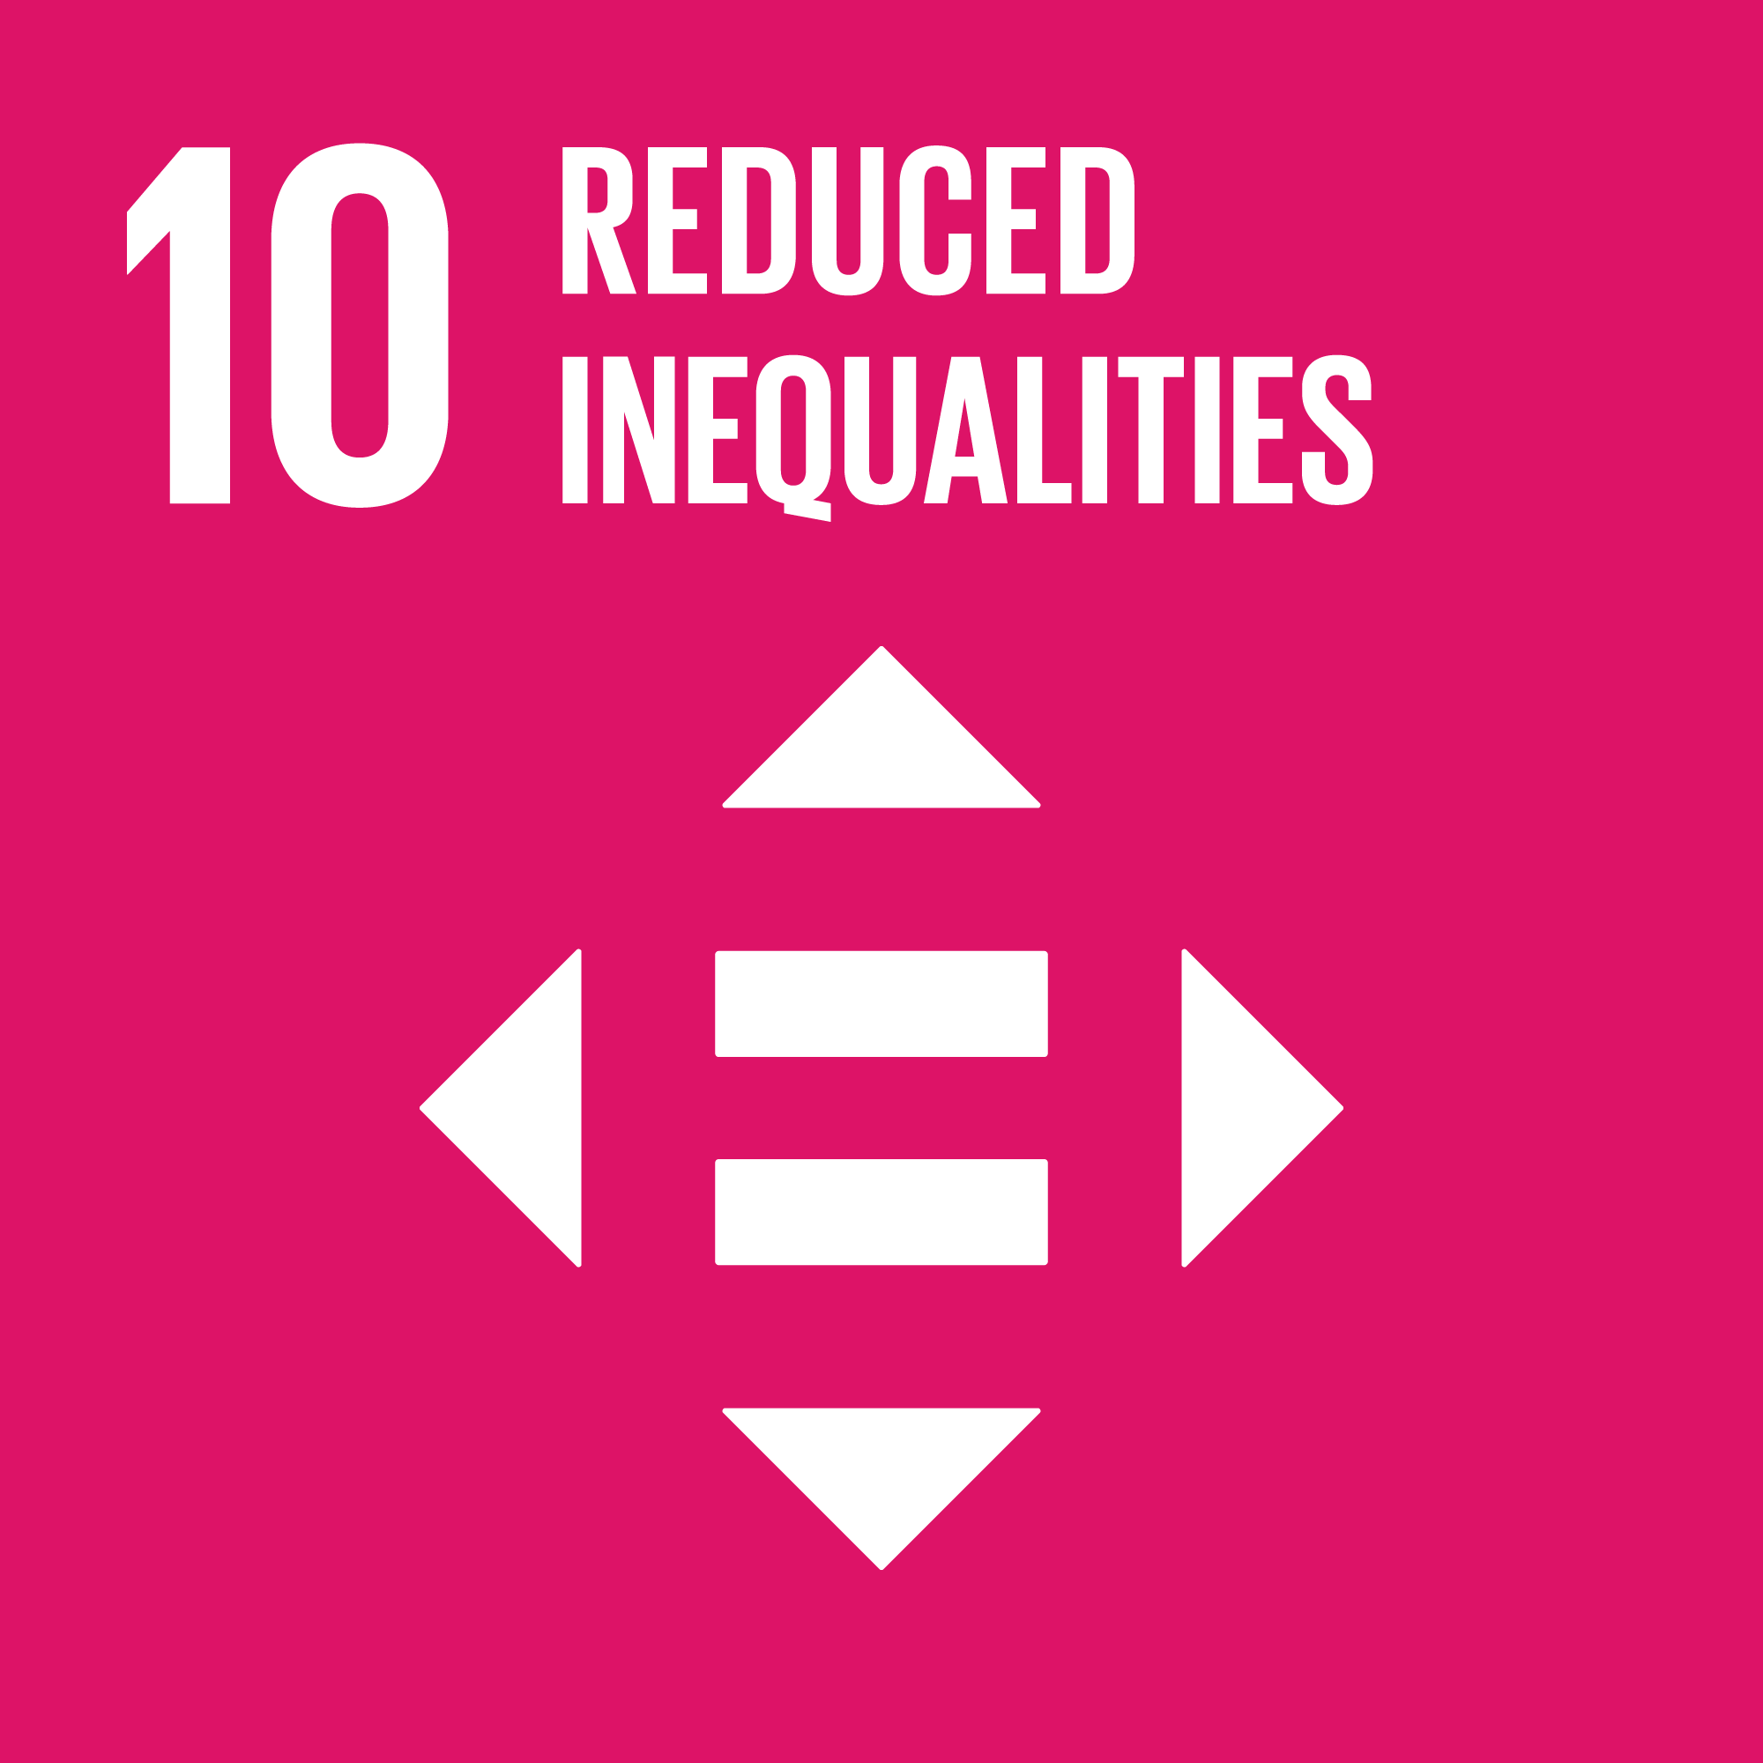
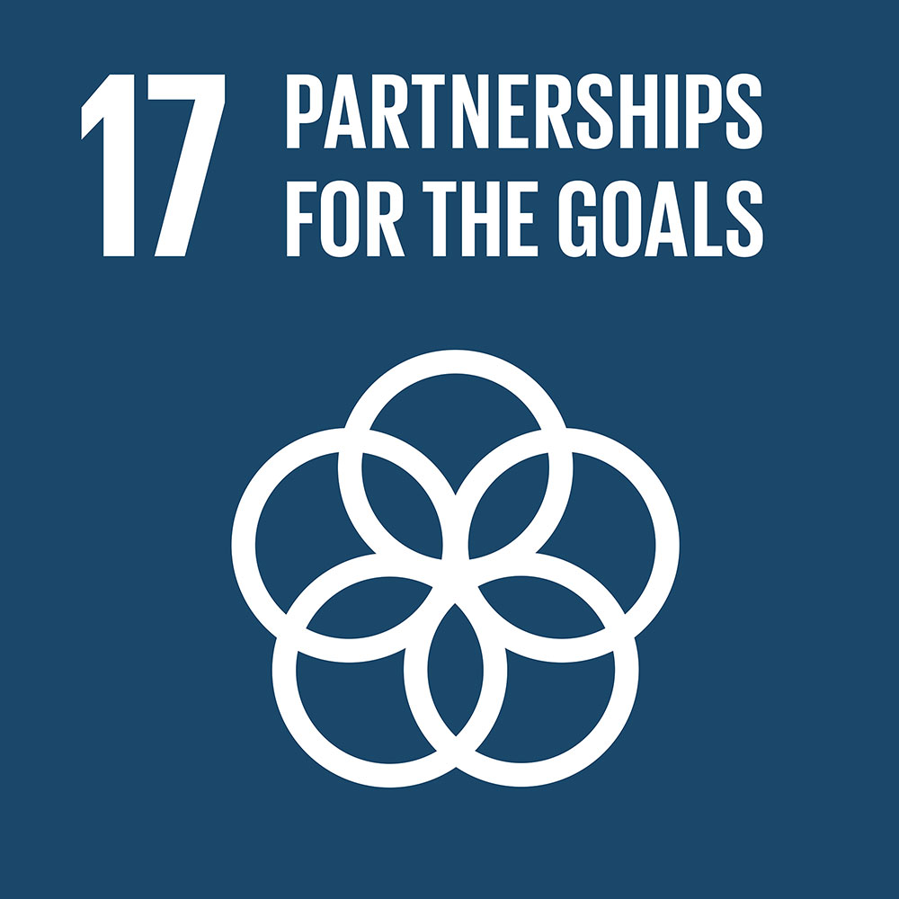
Activity 2
Zambia
Location: Southern Africa Population: 18.4 million
Story of progress: Ireland supported the development of a system to send text messages to disadvantaged families with important information about healthy eating.
Vietnam
Location: Southeast Asia Population: 97.3 million
Story of progress: In 2020, Ireland repaired 16 schools damaged during typhoons (tropical storms with extremely strong winds and heavy rainfall) in central Vietnam.
Slide 2 of 5 | Stories of progress
Notes:
Teacher notes: Activity 2/Slide 2 of 5 (Stories of progress) (no animations)
Read aloud the information about Zambia and Vietnam on the slide.
Think about the stories of progress in Zambia and Vietnam and the Global Goals that these are helping to make happen.
Tell a partner which of the stories of progress you find most interesting and why.

Slide 10
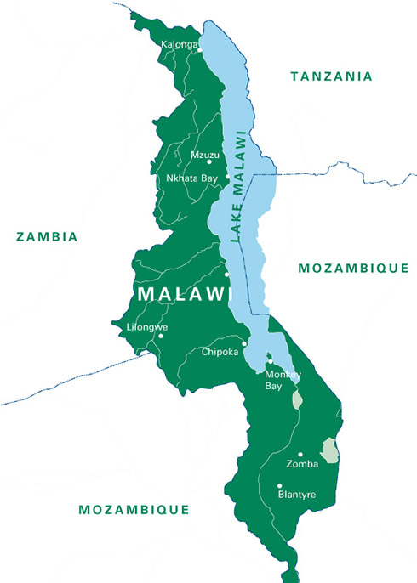
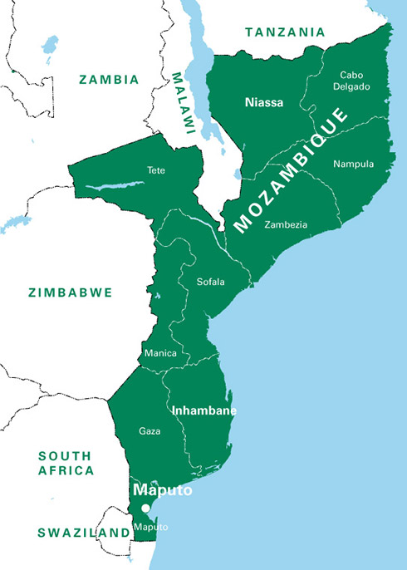
Activity 2
Malawi
Location: Southeast Africa Population: 19.1 million
Mozambique
Location: Southeast Africa Population: 31.2 million
Story of progress: In 2020, Ireland supported 271,947 people in Mozambique to get Covid-19 tests.
Story of progress: In 2020, with Ireland’s support, 40,501 cook stoves and 27,827 solar lamps were given to disadvantaged families in Malawi.
Slide 3 of 5 | Stories of progress
Notes:
Teacher notes: Activity 2/Slide 3 of 5 (Stories of progress) (2 animations at * Click)
Invite two pupils to read the information about Malawi and Mozambique on the slide.
* Click to animate in the map of Malawi with bordering countries
The country in green on the map is Malawi, and the surrounding countries in white are the countries that border or neighbour Malawi.
What is the name of the large lake (blue) on the map of Malawi? [answer = Lake Malawi, one of the deepest lakes in our world and home to hundreds of different types of freshwater fish]
* Click to animate in the map of Mozambique with bordering countries.
In this map, which country is Mozambique? [answer = the country in green]
Mozambique has lots of neighbouring or bordering countries. Can you name some of Mozambique’s bordering countries? [answer = Tanzania, Malawi, Zambia, Zimbabwe, South Africa, Swaziland]
What is the name of the lake at the northwest of Mozambique on the map (see arrow)? [answer = Lake Nyassa/Malawi]
Malawi and Mozambique are neighbours. This same lake is called Lake Nyassa in Mozambique, and Lake Malawi in Malawi.

Slide 11
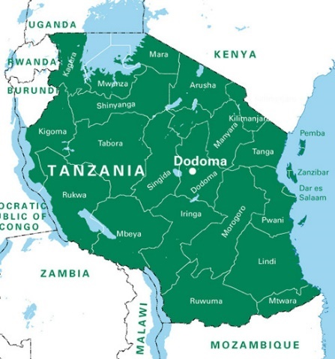
Activity 2
Ethiopia
Location: East Africa Population: 114.9 million
Story of progress: Ireland supported the United Nations World Health Organization (WHO) and the Ethiopian Ministry of Health to send new health workers to help in Covid-19 treatment and quarantine centres.
Tanzania
Location: East Africa Population: 59.7 million
Story of progress: Ireland supported efforts to stop the spread of Covid-19 between Tanzania and neighbouring countries by giving personal protective equipment to workers at ten border crossings.
Slide 4 of 5| Stories of progress
Notes:
Teacher notes: Activity 2/Slide 4 of 5 (Stories of progress) (no animations)
Invite two pupils to read the information about Ethiopia and Tanzania on the slide.
In Ethiopia, Irish Aid helped send new health workers to help in Covid-19 treatment and quarantine centres.
Can anyone explain what the word quarantine means? (answer = when someone stays at a safe distance from other people because they are sick or they have been in contact with someone who is sick and are waiting to see if they develop symptoms, for example with Covid-19.)
The word quarantine comes from the Italian words ‘quaranta giorni’ or ‘forty days’ because in the past people used to have to quarantine for 40 days if they were sick from or exposed to contagious diseases.
Can you name any of the countries that border Tanzania? [answer = Kenya, Mozambique, Zambia, Democratic Republic of Congo, Burundi, Rwanda and Uganda]
With all these bordering countries, Tanzania has lots of border crossings. Irish Aid gave personal equipment to workers at border crossings to try to stop Covid-19 spreading from one country to another.

Slide 12
Activity 2
Sierra Leone
Location: West Africa Population: 7.9 million
Story of progress: In 2020, Ireland supported the United Nations Population Fund (UNFPA) and a local Sierra Leonian non-governmental organization, Women in Crisis Movement, to give radios to girls from disadvantaged families so that they could listen to their lessons on air when schools closed because of Covid-19.
Uganda
Location: East Africa Population: 45.7 million
Story of progress: In 2020, Ireland gave €1.8 million to help the World Health Organization (WHO) fight against Covid-19 in Uganda.
Slide 5 of 5 | Stories of progress
Notes:
Teacher notes: Activity 2/Slide 5 of 5 (Stories of progress) (1 animation at * Click)
Invite two pupils to read the information about Sierra Leone and Uganda on the slide.
* Click to animate in the photo of a Woman in Crisis Movement staff member with a radio
What technology did you use to help with your learning during the Covid-19 school closures?
[possible answers = mobile phones or other devices, TV; programmes like RTE school hub, TG4 Cula4; apps like SeeSaw or Zoom; or specific websites/social media platforms]
Can you name the Global Goals which Irish Aid’s work in Uganda might be helping to achieve?
[possible answers = Goal 3: Good health and wellbeing; Goal 10: Reduced inequalities; and Goal 17: Partnership for the Goals]
Let’s go back to the starfish you drew earlier. (See Slide 7/notes)
Add any new information you now have about Irish Aid to (or around) the arms of your starfish.

Slide 13
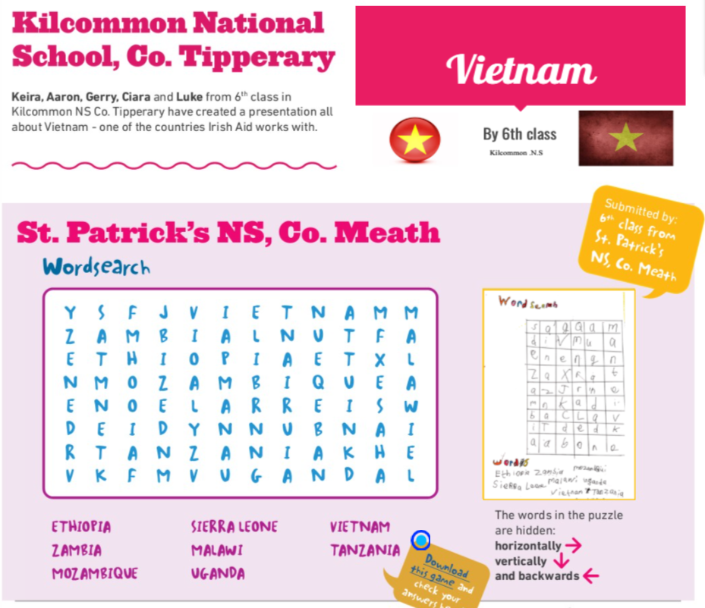
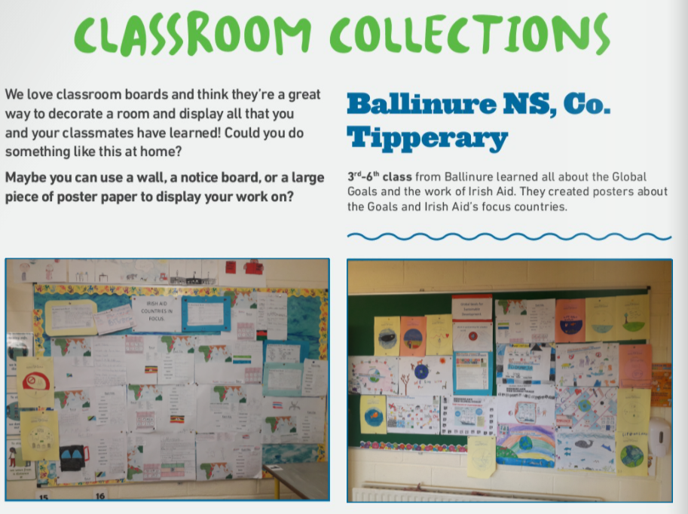
Activity 3
Here are some of the fantastic examples of pupils’ work included in 2021 Global Goal Getters magazines.
See https://www.ourworldirishaidawards.ie/global-goals-archive/ for more great examples.
Slide 1 of 1 | GLOBAL GOAL GETTERS
Notes:
Teacher notes: Activity 3/Slide 1 of 1 (Global Goal Getters) (3 consecutive animations at * Click)
We are going to take part in the Our World Irish Aid Awards.
* Click to animate in three different examples of Award entries received in 2021
Read the narrative provided for each entry and comment on the format (St Fiachra’s SNS = animation; Ballinure NS = classroom display; Kilcommon National School = word search) and the focus of the three entries (Irish Aid’s work in different countries around our world).
The format for Awards entries is wide open; we can submit video, audio, written, or multimedia entries. This means we can enter fact files about countries where Irish Aid works, or a quiz based on Irish Aid stories of progress (Slides 9-12), short stories, poems, surveys, performances, drawings etc.
Our entries must be about the 2022 Awards theme of ‘Wellbeing for people and planet’, the Global Goals generally and/or the work of Irish Aid in different countries.
Another great thing about the Awards is that we can take as much or as little time as we like to create our entry and we can enter more than once!
Everyone who enters will get a certificate of participation.
Selected entries will feature in one of two, Global Goal Getters online magazines, by kids, for kids on www.ourworldirishaidaward.ie.
The best entries overall will appear in our Global Goal Getters Annual published in June 2022, available online and as an insert in a national newspaper. These teachers/pupils will also be invited to attend a National Awards ceremony in June 2022. Each winner will receive copies of the Global Goal Getters Annual and a plaque or trophy for their school.
For more support, see Lessons 1, 3 and 4 and check out the fantastic entries featured in the last year’s Global Goal Getters: https://www.ourworldirishaidawards.ie/global-goals-archive/
EARLY SUBMISSIONS CLOSING DATE: Monday, 7TH February 2022
School entries received on or before 7th February 2022 are in with a chance to win a box of sustainable art materials.
FINAL CLOSING DATE: Friday, 8th April 2022
Please complete an Entry Form (available in your teacher pack or for download from our website) and submit your work via email: ourworld@realnation.ie or by post to: Our World Irish Aid Awards
Real Nation
24 Arran Quay Dublin 7
D07 W620 Further information is available: www.ourworldirishaidaward.ie You can also email or ring our project office if you have any queries about the Our World Irish Aid Awards or submission details E: ourworld@realnation.ie / P: 01 522 4834
We would love to hear about how you are getting on with the curriculum materials and Award entries. You can share your Our World Irish Aid Awards 2022 journey with us @Irish_Aid / @ourworldirishaidawards on social media using the hashtag #ourworldawards
DID YOU KNOW?
Additional Irish Aid primary resources are available: https://www.irishaid.ie/teaching-and-learning/primary/

Slide 14
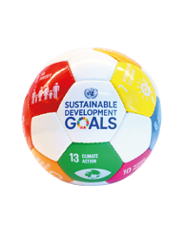
We have learned to…
identify what Irish Aid is and does
discuss the links between Irish Aid work around our world and the Global Goals
reflect on the importance of making a difference
WELL DONE CLASS!
You’re all amazing
Global Goal Getters!
Slide 1 of 1 | Reflection on learning
Notes:
Teacher notes: Reflection on learning (4 animations at * Click – 3 come in one after another on the 2nd Click)
Let’s take a few minutes to think about (reflect) on what we have learned in this lesson.
Imagine you are playing basketball.
As each of the things you were learning in this lesson appear on the board, you should mime:
Shooting and scoring the winning basket in the match – if you are happy that you have learned what is on the board
* Click to animate the ball dropping into the net to demonstrate what you mean
Dribbling the ball – if you still need a little support from either myself or your classmates to be able to say that you have learned what is on the board
* Click to animate each of the 3 learning intentions for this lesson in separately, reading each aloud as they appear.
Observe pupils to see who might need some extra support.
You have all done an amazing job and are all fantastic Global Goal Getters.
Don’t forget to check out www.ourworldirishaidaward.ie for information about how to get your pupils’ work published in one of our 2022 Global Goal Getters online magazines, by kids, for kids!

Slide 15
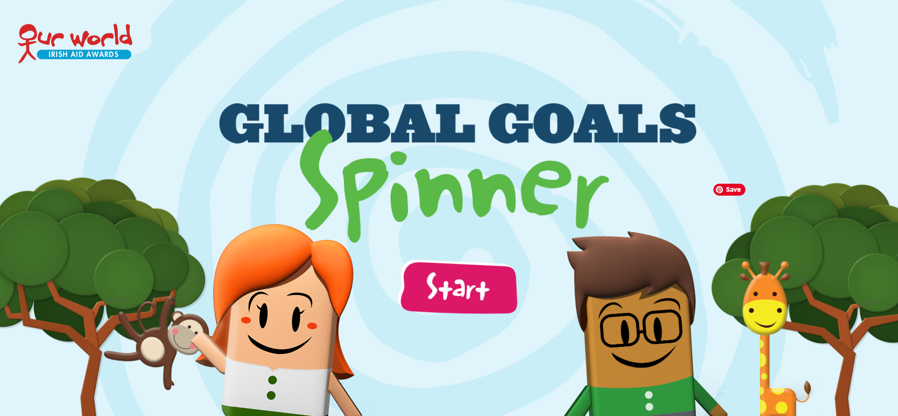
In your own time…
Notes:
Teacher notes: In your own time (no animations)
Depending on your class, you might like to encourage your pupils to test their what they have learned about the Global Goals and the work of Irish Aid by competing against the clock in our online Global Goal Spinner Game, available: https://globalspinner.ourworldirishaidawards.ie/#/game/play

