Slide 1
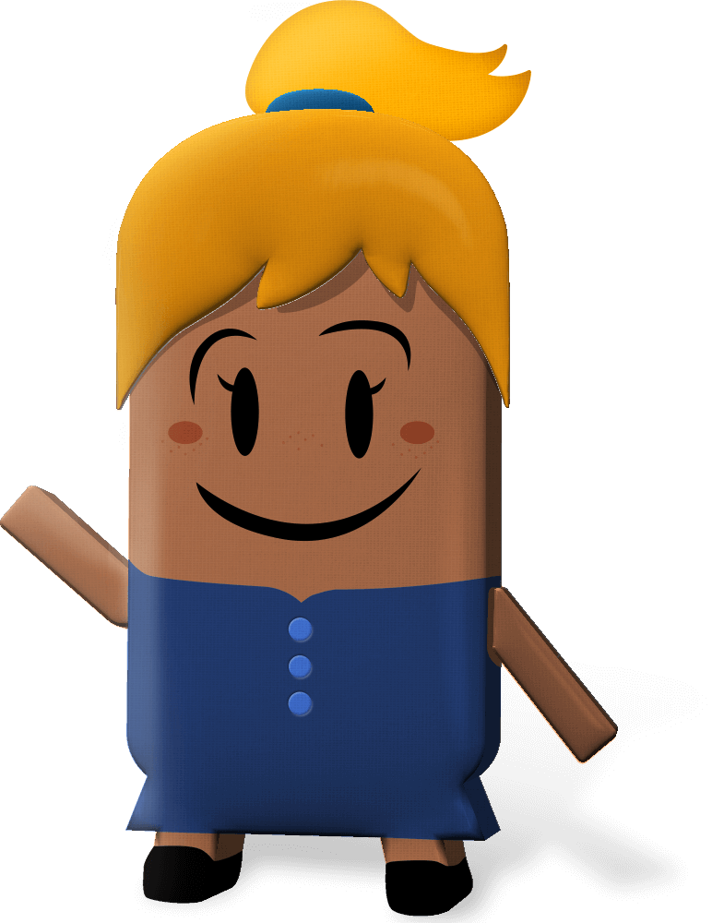
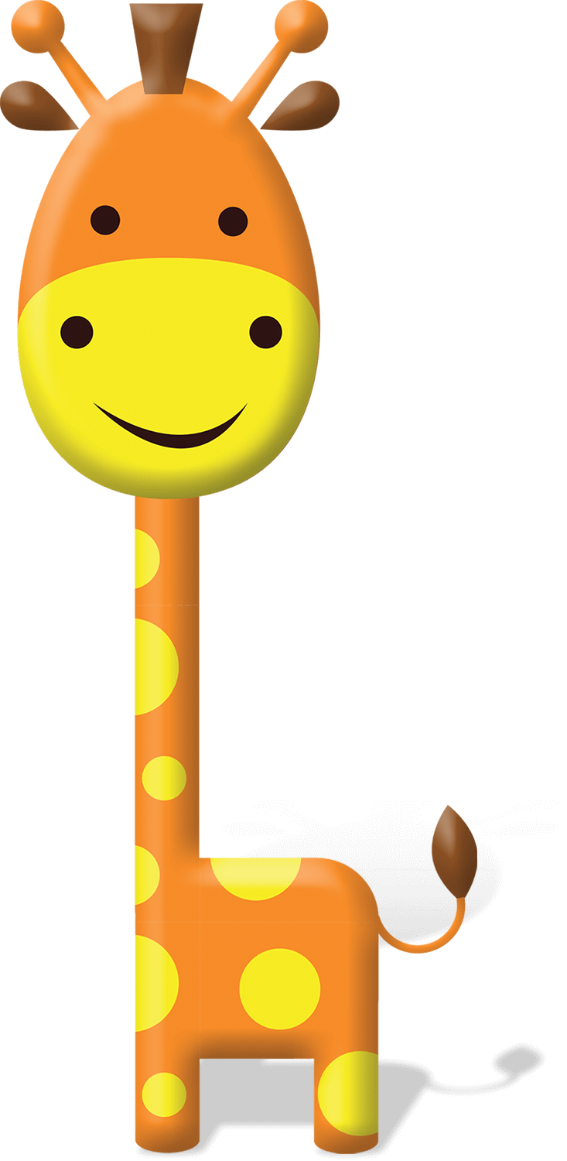
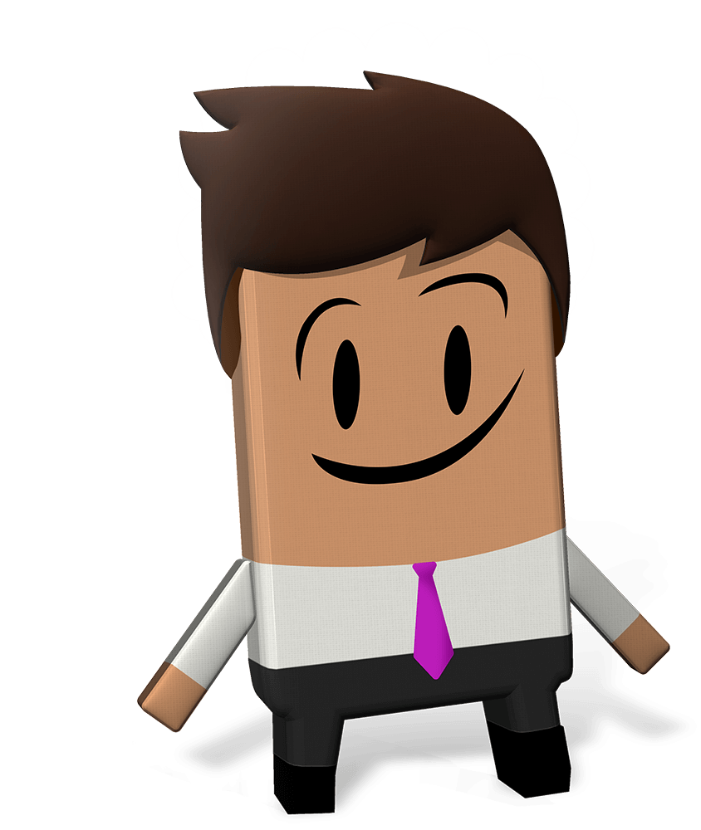
OUR WORLD IRISH AID AWARDS 2022
“WELLBEING FOR PEOPLE AND PLANET”
LESSON ONE
(3rd-4th class)
Notes:
Dear 3rd-4th class teacher,
Welcome to the first of four lessons for 3rd-4th class available for the 2022 Our World Irish Aid Awards.*
Irish Aid is the official overseas development cooperation programme of the Irish Government. The Government’s overseas development cooperation programme focuses on the realization of the United Nations Sustainable Development Goals with a specific emphasis on gender equality, reducing humanitarian need, supporting climate action, and strengthening governance in countries all around our world.
The Our World Irish Aid Awards were established in 2005 to encourage primary aged pupils to learn about how Ireland, through the Irish Aid programme, is working on these issues with international organizations (like the United Nations and the European Union), with governments, non-governmental organizations (NGOs), and with communities of people.
We are delighted that you have decided to take part in the Awards this year. You may have already engaged with the 2022 Our World Irish Aid Awards pupils’ magazine and you are now beginning the Our World Irish Aid Award lessons. We hope that your class finds the activities and stories in the magazine and lessons engaging and fun and go on to generate and submit their own content for publication in our Global Goal Getters online magazines by kids, for kids.
EARLY SUBMISSIONS CLOSING DATE: Monday, 7TH February 2022
School entries received on or before 7th February 2022 are in with a chance to win a box of sustainable art materials.
FINAL CLOSING DATE: Friday, 8th April 2022
For support, more details and information about how to submit pupil’s work for the Global Goal Getters online magazine see www.ourworldirishaidawards.ie
All lessons are designed for approximately 45 minutes of class contact time. They are curriculum linked (see Slide 2) and classroom-ready, with minimal preparation required. All that remains is for you to read through the teacher notes (available at the bottom of each slide when in ‘normal’ mode) and familiarise yourself with the animations (using ‘presenter’ mode) in advance of class.
Depending on your version of PowerPoint you may be able to view the slide notes while presenting, but don’t worry, if not, you can access and print a pdf of the slide notes as a support for you during class on our website.
We recognise that as their teacher, you know your own pupils very well. For this reason, the slides are fully editable so that, if necessary, you can tweak the lesson to best suit the context and needs of the children in your class. You may also find it helpful to consult our Good Practice Guidelines for teaching about poverty and development, also available on our website.
*If you have colleagues teaching 5th-6th class, you might like to let them know that lessons linked to the 5th-6th class curriculum are available on www.ourworldirishaidawards.ie
Every year we are blown away by the creativity and innovation of the teachers and pupils around the country who take part in the Awards. We can’t wait to see where you go with this year’s theme of ‘Wellbeing for people and planet’. Remember to share your Our World Irish Aid Awards 2022 journey with us @Irish_Aid / @ourworldirishaidawards on social media using the hashtag #ourworldawards.
All the very best to you and your wonderful pupils.
The Our World Irish Aid Award team

Slide 2
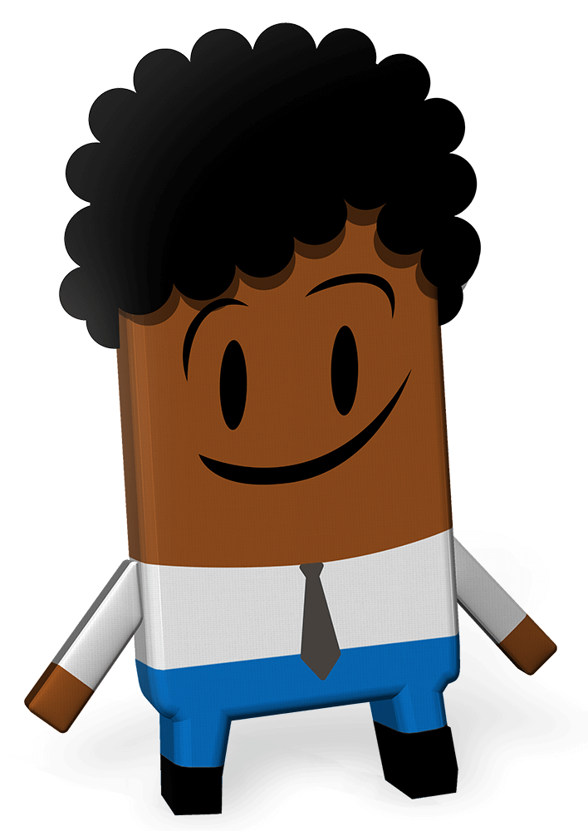
Curriculum Links
Curriculum area | Subject | Strand
SESE | Geography | Human environments
 | Science | Environmental awareness and care
SPHE |  | Myself Myself and others Myself and the wider world
Primary language | English | Oral language Reading Writing
 | Gaeilge | Teanga ó Bhéal Léitheoireacht Scríbhneoireacht
Arts Education | Visual Art | Drawing
Notes:
Teacher notes (none)

Slide 3
Lesson Content
Activity No. | Activity name | Methodologies | Slide No.
Learning intentions |  | Sharing the learning intentions | 4
1 | Wellbeing | Whole class discussion | poem | 5
2 | Global Goals for Sustainable Development | Input on the 17 Global Goals | Short video | whole class discussion | 6-8
3 | Picturing 2030 | Input | individual artwork | Early finisher/extension numeracy task | 9
4 | Global Goal Getters | Thinking about our 2022 Our World Irish Aid Awards entries: input | 10
Reflection on learning |  | Checking in with the learning intentions | 11
Notes:
Teacher notes (none)

Slide 4
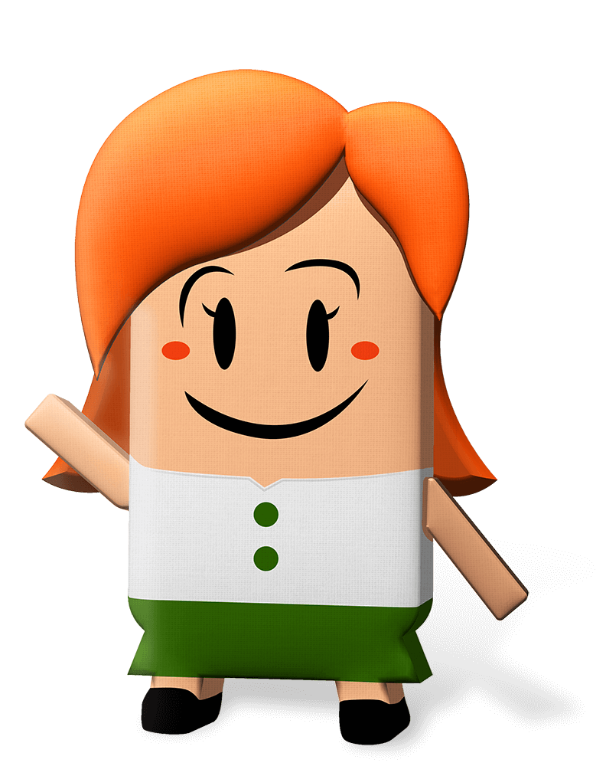
We are learning to…
consider what ‘wellbeing’ means for people and planet
explore the Global Goals for Sustainable Development
imagine a world where the Global Goals have happened
Notes:
Teacher notes: Learning intentions (3 consecutive animations at * Click)
Sensitivity note: As their teacher, you know your own pupils well. Please feel free to edit the learning intentions and the activities in this lesson to best suit the context and needs of the children in your class.
See also our Good Practice Guidelines for teaching about poverty and development in the lesson plan section of our website: www.ourworldirishaidawards.ie
* Click to animate in the three learning intentions for this lesson, one after another, reading aloud as you go.
This is the first lesson for the 2022 Our World Irish Aid Awards. This lesson is all about the idea of ‘wellbeing’ and how we can work for the wellbeing of all people and our planet by helping to make the Global Goals for Sustainable Development happen.
You don’t need to worry if you don’t know what wellbeing means, or if you haven’t heard about the Global Goals for Sustainable Development before. This will all become clear.
Depending on your class, you might like to share that they will be entering some of their work to the Our World Irish Aid Awards. The Our World Irish Aid Awards are a way for children and young people, like the pupils in your class, to learn about what Irish Aid does, to learn about the Global Goals, and to think about ways that they can work for the wellbeing of people and planet.
Do you see the Irish Aid logo in the bottom right of the slide?
Irish Aid is part of the Irish Government. Irish Aid works for the wellbeing of people and our planet. Irish Aid does this by working with other governments, with different groups (non-governmental organizations (NGOs) or charities), and with communities in lots of countries around our world. You will be learning more about the work of Irish Aid as we go through the different lessons.

Slide 5
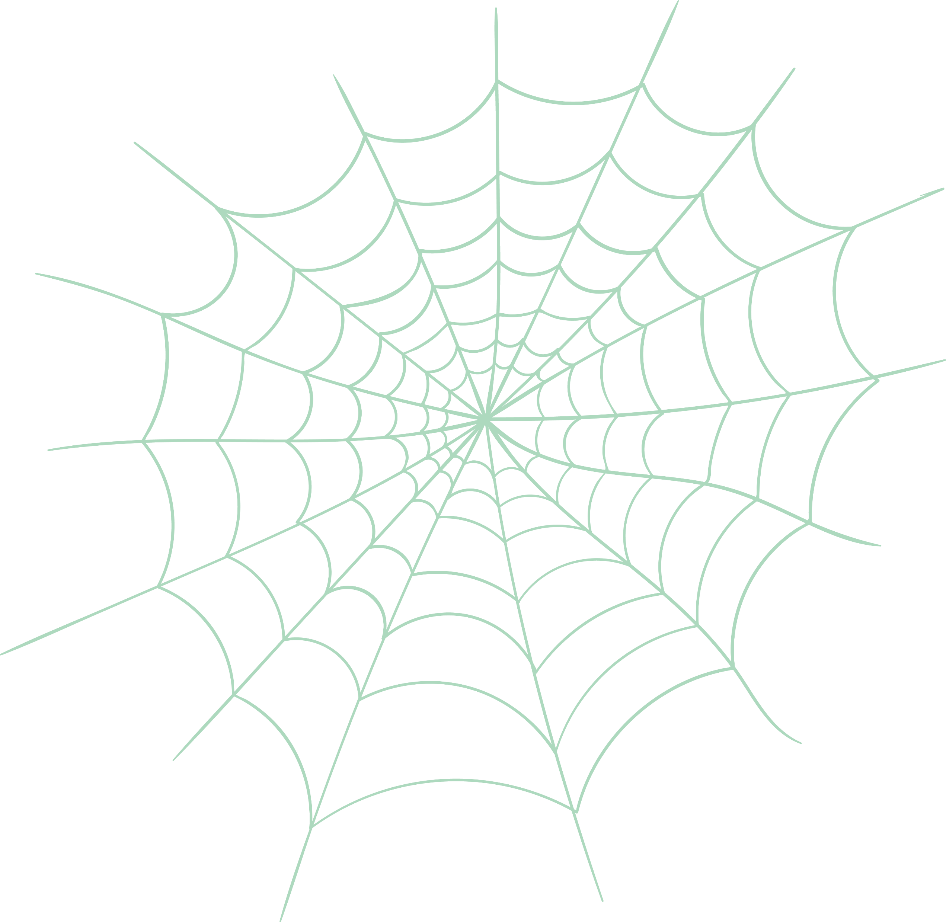
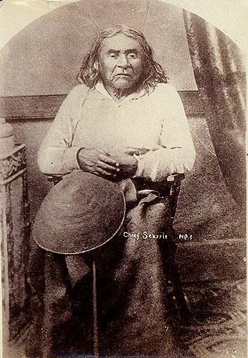
Activity 1
Humankind has not woven the web of life.
We are but one thread within it.
Whatever we do to the web
we do to ourselves.
All things are bound together.
All things connect.
Slide 1 of 1 | WELLBEING
Notes:
Teacher notes: Activity 1/Slide 1 of 1 (Wellbeing) (no animations)
Read the poem on the slide aloud.
Share details about Chief Si’ahl (Seattle) and the context for his poem (see short biography below).
An analogy is when you explain something by comparing it to something else. For example: ‘that box is as light as a feather’.
What is the analogy that is used in this poem? (Answer = a spider’s web).
Why does Chief Si’ahl use the analogy of a spider’s web? (Answer = Like a spider’s web, the people, places, plants and animals on our planet are connected and depend on each other).
Our planet is also like a spider’s web because it is very strong and flexible, but if one strand gets damaged, all are affected.
Chief Si’ahl (Seattle) is saying that our planet, and everything in it, is connected. This means that what people do in one place can have a big impact on the health and happiness of other people and on other places. We all live on our planet, and we depend on our planet to live. The wellbeing of people and planet are very closely connected.
Who or what helps you to be and feel well (healthy, happy, and connected)?
Use the following prompt questions to help pupils think about the people, things, and places that they rely on in their everyday lives:
Who/what do you love spending time with or on?
Who/what helps you when you are grumpy or having a bad day?
Who looks after you to make sure that you are well, making sure that you can grow up strong, healthy, and with a good education?
Where does the food you eat come from?
Who/what helps you to exercise and stay fit?
Who writes the music you listen to, the books you read or the movies you watch?
Who makes the clothes you wear?
Who built the roads where you live, the school where you go to learn, and the playground where you meet up with friends?
These are examples of people, things, and places that you rely on for your wellbeing. As we all learn to live with COVID-19, it’s more important than ever that we are kind to ourselves and look after each other and our planet.
Chief Si’ahl (Seattle) – short biography
Chief Si’ahl (pronounced Seattle by European-Americans) was thought to have been born in the mid-1780s in a place now called the Puget Sound in the state of Washington in America. He was the son of a chief of the Suqamish tribe, and his mother was from the Duwamish tribe. He is known to have welcomed early European-Americans who came to settle in the area and these settlers later named Seattle (now a city) after him.

Slide 6
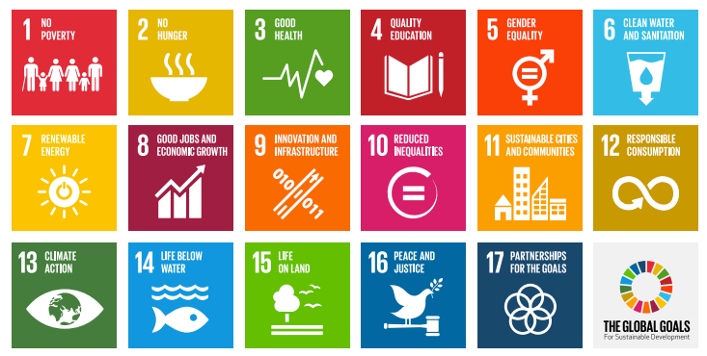
Activity 2
All countries in the United Nations agreed to achieve 17 Global Goals by the year 2030
The Global Goals are designed to help improve the wellbeing of people and planet
Everyone needs to work together to make sure that we get them done
Slide 1 of 4 | Global Goals for Sustainable Development
Notes:
Teacher notes: Activity 2/Slide 1 of 4 (Global Goals for Sustainable Development) (3 animations at * Click)
Have you ever seen this image with the coloured boxes, numbers and icons before? These are called the Sustainable Development Goals, or sometimes they are called the Global Goals.
* Click to animate in the first bullet point
The 17 Global Goals are a plan that was designed by all of the countries in the United Nations.
The United Nations is a big organization, like a club, which makes decisions about our world. Ireland is one of the 193 countries that is part of the United Nations.
* Click to animate in the second bullet point
The Global Goals are about working together for the wellbeing of all people, everywhere. They talk about things like being able to go to school to learn and go to a doctor when you are sick, about having enough good food to eat, about being treated fairly and being paid fairly for the work that you do. The Goals are also about the wellbeing of our planet, which we depend upon for our survival and our wellbeing. The Goals ask that people think about buying less, so that we don’t use up too many of our world’s resources; and about looking after all the creatures and living things that exist on our planet.
* Click to animate in the third bullet point
The Global Goals are universal. This means that they are for everyone and especially the people in our world who are most at risk – people who do not have enough good food or clean water to live well or cannot afford to send their children to school or get medical help when they need it. The fact that the Goals are universal also means that we all have a responsibility to do something about the Global Goals. We all have a part to play in making them happen.
Further information about the Global Goals available: https://sdgs.un.org/goals; https://www.globalgoals.org/

Slide 7
Activity 2
Slide 2 of 4 | Global Goals for Sustainable Development
Notes:
Teacher notes: Activity 2/Slide 2 of 4 (Global Goals for Sustainable Development) (no animations)
Has anyone ever heard of Malala Yousafzai? What do you know about Malala? (see short biography below).
Malala is an activist, or someone who takes action to bring about positive change in our world. She focuses on helping girls go to and stay in school.
Play the short video (6.19mins), introduced by Malala and about the Global Goals by clicking on the image on the slide (also available: https://www.youtube.com/watch?v=p2hyORs83EE (English language version) or https://youtu.be/fpjIu2446PY (Irish version).
Malala Yousafzai – short biography
Malala Yousafzai was born in the Swat Valley in Pakistan, in 1997. When she was younger, Malala’s basic right to education was threatened when the Taliban (a militant Islamic group) took control in the Swat Valley. Because of this, Malala is an activist, who is known for speaking out about the need to support the education of girls and women. In 2014, Malala was awarded the Nobel Peace Prize. The Malala Fund is a charity run by Malala which supports girls to go to and stay in school.

Slide 8
Activity 2
Wellbeing for people and planet
Wellbeing for people
Wellbeing for planet
Slide 3 of 4 | Global Goals for Sustainable Development
Notes:
Teacher notes: Activity 2/Slide 3 of 4 (Global Goals for Sustainable Development) (1 animation at * Click)
Copy the table (left side on Slide 7) into your copy/on a piece of paper.
As I go through each of the 17 Global Goals, write the numbers of the Global Goals you think are most important for:
the wellbeing of people (when people are healthy and happy and have positive (good) connections to people and places, near and far) into the first column (left)
the wellbeing of our planet in the second column (right)
If you think that a Goal is important for both the wellbeing of people and our planet, write the Goal number in both columns.
Read through the 17 Global Goals (below), allowing enough time for pupils to note the Goal numbers in one or both columns.
Ask a selection of pupils for feedback.
* Click to animate in the heading ‘wellbeing for people and planet’ over the image of the Global Goals
Remember what Chief Seattle said about all things being ‘bound together’ and all things being connected? While it is more obvious for some Goals than others, all 17 Goals are actually important for the wellbeing of both people and our planet. So, for example, looking after the life in our oceans and seas (Goal 14) will help the wellbeing of our planet, but it will also help people who rely on the oceans, lakes, and rivers for a job or to make a living (Goal 8) and for food (Goal 2). Or, making sure that everyone in our world is able to go to school and get a good education (Goal 4), including learning about the importance of reducing, reusing and recycling (Goal 12), can also help to fight climate change (Goal 13).
17 Global Goals
1. End poverty – make sure that everyone has enough money or resources to survive
2. End hunger - make sure that everyone, everywhere has enough good food to eat so that they can grow and be healthy.
3. Make sure everyone can live healthy lives, with proper medical help if they get sick
4. Make sure everyone gets a good education
5. Make sure that women and girls get the same chances in life as men and boys
6. Make sure that everyone has access to clean water and proper toilets
7. Make sure that everyone has enough heat, light, and power without damaging the environment
8. Help countries to develop and provide good jobs in a way that benefits everyone
9. Build schools, hospitals, and roads, and promote businesses and industries that make all people’s lives better
10. Make sure that everyone is treated fairly, and that countries treat each other fairly
11. Make cities environmentally friendly and safe communities, where all people can live well
12. Make sure we do not buy too many things so that we do not use up the earth’s scarce resources (reduce, reuse, recycle)
13. Act now to fight climate change
14. Look after the life in our oceans and seas
15. Look after forests, animals, and the earth itself
16. Work for peace and justice inside and between countries
17. Countries will work together to achieve the Global Goals for the wellbeing of people and our planet

Slide 9
Activity 3
2022
2030
Slide 1 of 1 | Picturing 2030
Notes:
Teacher notes: Activity 3/Slide 1 of 1 (Picturing 2030) (2 animations at * Click)
What do you see on Slide 9? (Answer = ‘2030’ (as in the year 2030) using different styles of numbers and a clock standing in for the last zero).
Why do you think the year 2030 is on Slide 9? (Answer = 193 countries, including Ireland, have promised to work to achieve the 17 Global Goals by the year 2030).
* Click to animate the countdown from 2022 to 2030
Close your eyes and imagine that you are living in a world where the Global Goals have been realised.
There are many good things about our world in 2030, including the fact that:
Everyone has enough money/resources to survive
That there has been a steady decrease in global carbon emissions (the gasses that are released into our planet’s atmosphere when we burn non-renewable fossil fuels, like oil or coal)
Much fewer children are getting sick
Half of our politicians (elected leaders) are women and half our men
Everyone has internet access
All children get enough good food to eat so they can grow up healthy
All children finish primary and secondary school
Use bubble writing to write ‘2030’ in your copy/on a piece of paper.
Depending on your class, you may need to explain that bubble writing is when numbers (or letters) look puffy like bubbles – like the numbers on Slide 9.
Be inspired by your ideas about what our world might look and be like if the Global Goals happened. Write/or draw these ideas on your ‘2030’. You might also take inspiration from the icons and colours of the Global Goals.
Depending on your class, you might like to pause ‘World’s largest lesson: introduced by Malala’ video (Slide 7) at 4.19 mins to see a sample 2030 with drawings/decoration.
Early finisher/Extension task:
Work out how many years (or months) are left between now and 2030

Slide 10
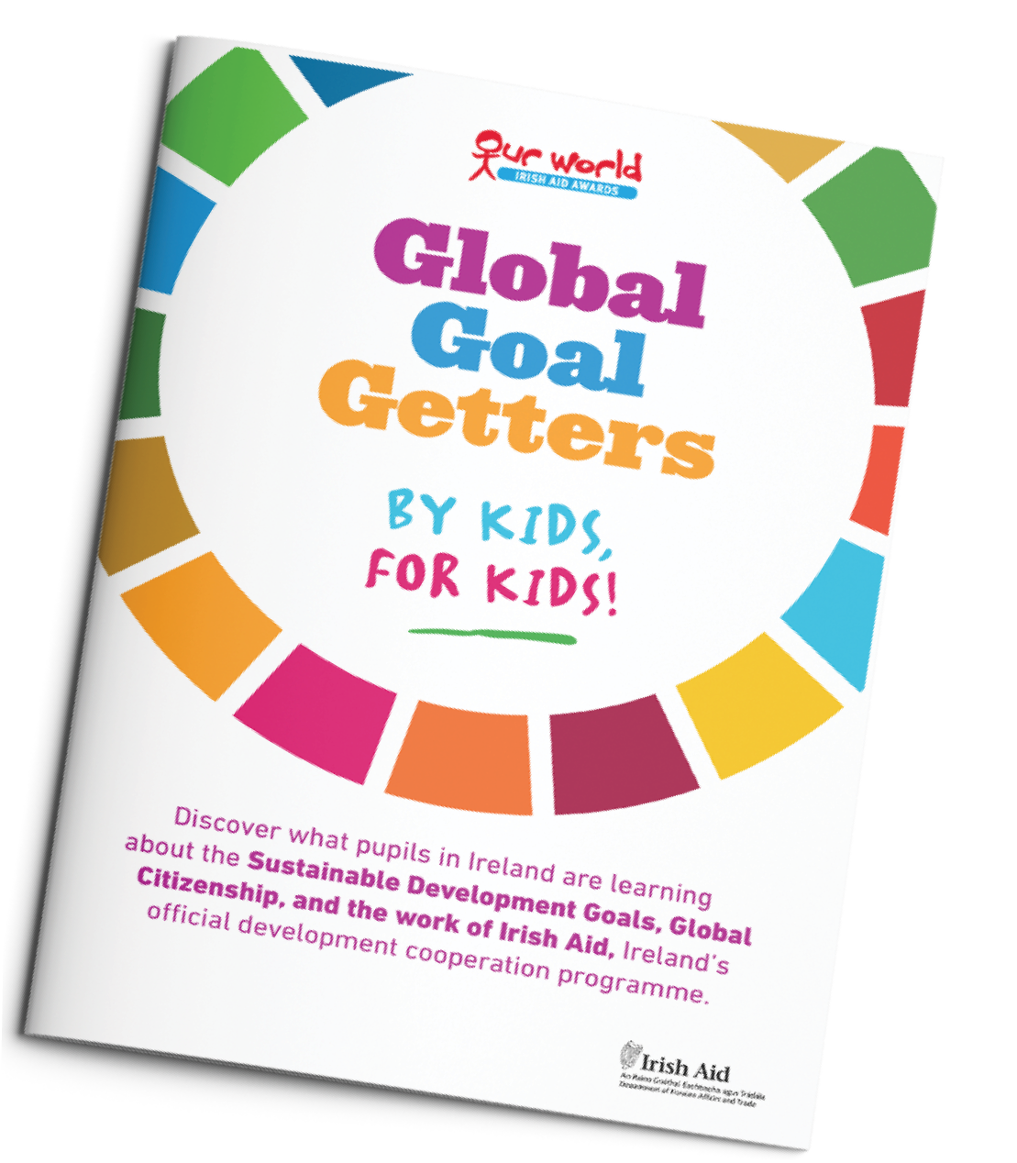
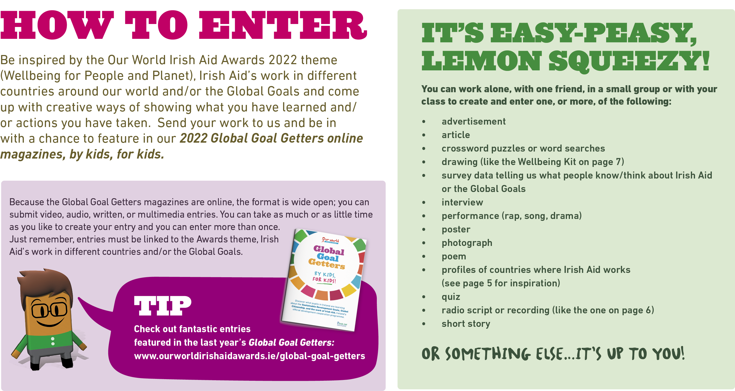
Activity 4
Slide 1 of 1 | GLOBAL GOAL GETTERS
Notes:
Teacher notes: Activity 4/Slide 1 of 1 (Global Goal Getters)
We are going to take part in the Our World Irish Aid Awards.
The format for Awards entries is wide open; we can submit video, audio, written, or multimedia entries. This means we can enter postcards (like the one you just did!), short stories, poems, surveys, performances, drawings etc.
Our entries must be about the 2022 Awards theme of ‘Wellbeing for people and planet’, the Global Goals generally and/or the work of Irish Aid in different countries.
Another great thing about the Awards is that we can take as much or as little time as we like to create our entry and we can enter more than once!
Everyone who enters will get a certificate of participation.
Selected entries will feature in one of two, Global Goal Getters magazines, by kids, for kids on www.ourworldirishaidaward.ie.
The best entries overall will appear in our Global Goal Getters Annual published in June 2022, available online and as an insert in a national newspaper. These teachers/pupils will also be invited to attend a National Awards ceremony in June 2022. Each winner will receive copies of the Global Goal Getters Annual and a plaque or trophy for their school.
For more support, see Lessons 2-4 and check out the fantastic entries featured in the last year’s Global Goal Getters: https://www.ourworldirishaidawards.ie/global-goals-archive/
EARLY SUBMISSIONS CLOSING DATE: Monday, 7th February 2022
School entries received on or before 7th February 2022 are in with a chance to win a box of sustainable art materials.
FINAL CLOSING DATE: Friday, 8th April 2022
Please complete an Entry Form (available in your teacher pack or for download from our website) and submit your work via email: ourworld@realnation.ie or by post to: Our World Irish Aid Awards
Real Nation
24 Arran Quay Dublin 7
D07 W620 Further information is available: www.ourworldirishaidaward.ie You can also email or ring our project office if you have any queries about the Our World Irish Aid Awards or submission details E: ourworld@realnation.ie / P: 01 522 4834
We would love to hear about how you are getting on with the curriculum materials and Award entries. You can share your Our World Irish Aid Awards 2022 journey with us @Irish_Aid / @ourworldirishaidawards on social media using the hashtag #ourworldawards
DID YOU KNOW?
Additional Irish Aid primary resources are available: https://www.irishaid.ie/teaching-and-learning/primary/

Slide 11
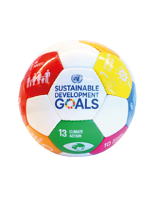
We have learned to…
consider what ‘wellbeing’ means for people and planet
explore the Global Goals for Sustainable Development
imagine a world where the Global Goals have happened
WELL DONE CLASS!
You’re all amazing
Global Goal Getters!
Slide 1 of 1 | Reflection on learning
Notes:
Teacher notes: (4 animations at * Click – 3 come in one after another on the 2nd Click)
Let’s take a few minutes to think about (reflect) on what we have learned in this lesson.
Imagine you are playing basketball.
As each of the things you were learning in this lesson appear on the board, you should mime:
Shooting and scoring the winning basket in the match – if you are happy that you have learned what is on the board
* Click to animate the ball dropping into the net to demonstrate what you mean
Dribbling the ball – if you still need a little support from either myself or your classmates to be able to say that you have learned what is on the board
* Click to animate each of the 3 learning intentions for this lesson in separately, reading each aloud as they appear.
Observe pupils to see who might need some extra support.
You have all done an amazing job and are all fantastic Global Goal Getters.
Don’t forget to check out www.ourworldirishaidawards.ie for information about how to get your pupils work published in one of our 2022 Global Goal Getters online magazines, by kids, for kids!

