Slide 1
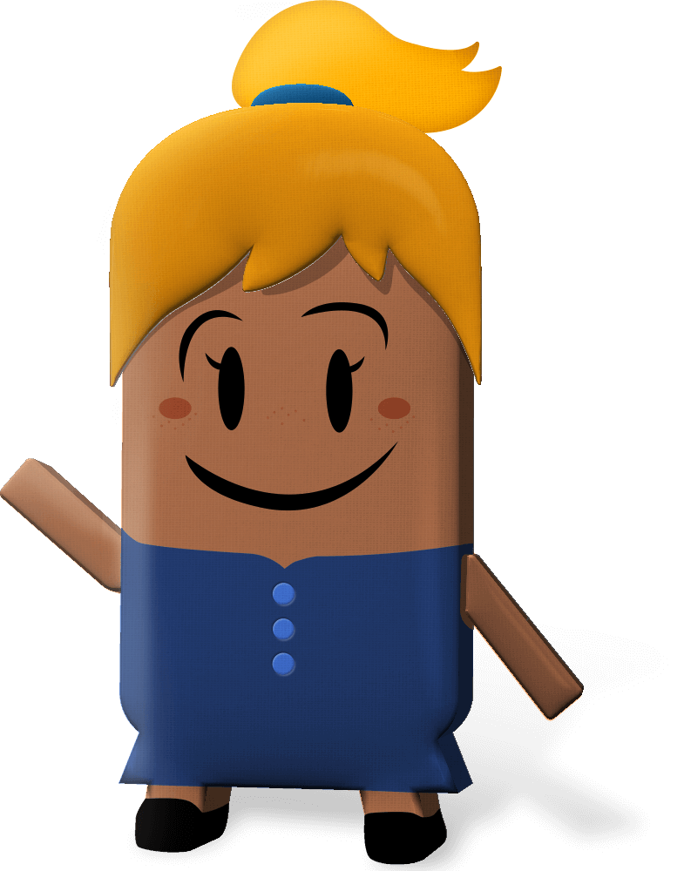
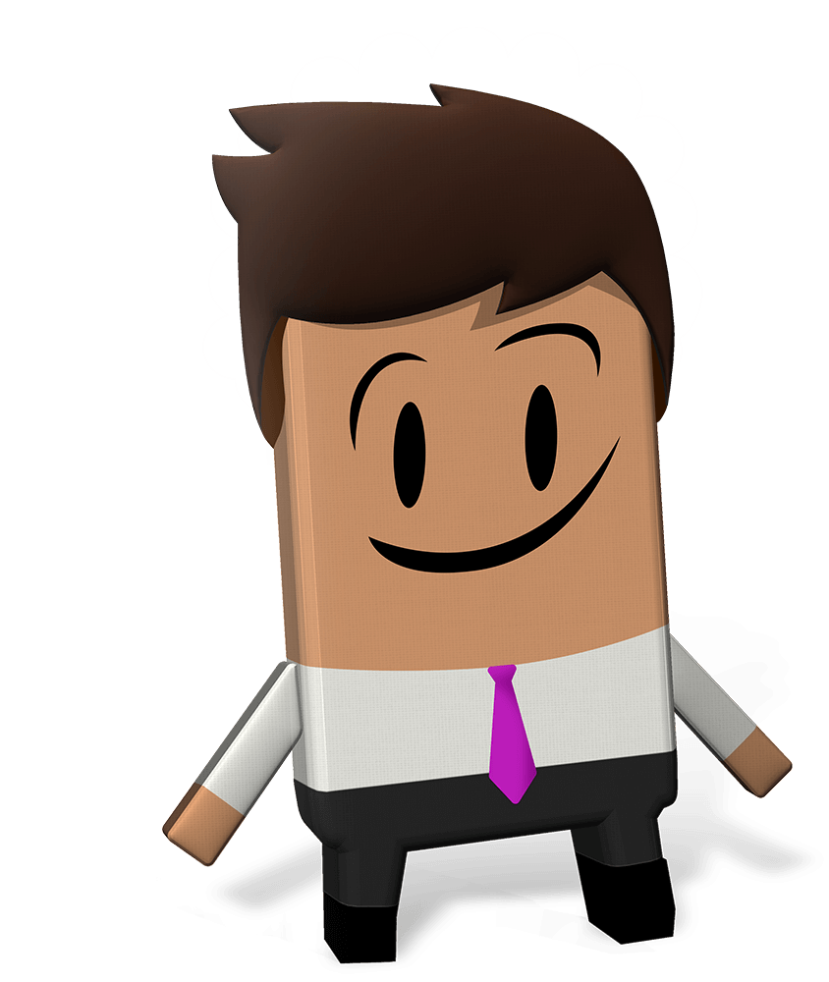
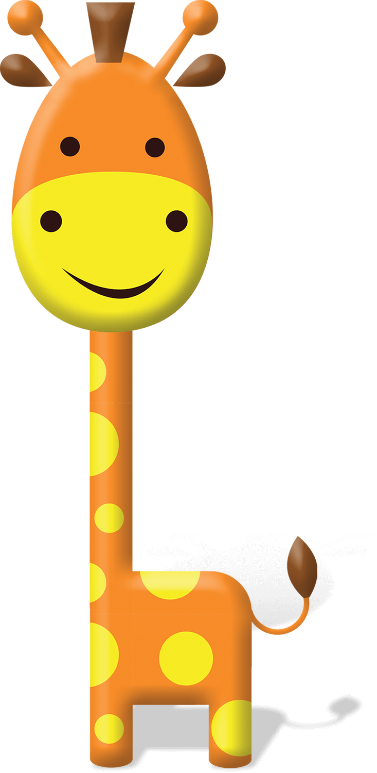
OUR WORLD IRISH AID AWARDS 2021
“Partnership for the Goals”
LESSON ONE
(5th-6th class)
Notes:
Dear 5th-6th class teacher,
Welcome to the first of four lessons for 5th-6th class available for the 2021 Our World Irish Aid Awards.*
Irish Aid is the official overseas development cooperation programme of the Irish Government. The Government’s overseas development programme focuses on the realization of the United Nations Sustainable Development Goals with a specific emphasis on gender equality, reducing humanitarian need, supporting climate action, and strengthening governance in over 130 countries. The Our World Irish Aid Awards were established in 2005 to encourage primary aged pupils to learn about how Ireland, through the Irish Aid programme, is working on these issues in partnership international organizations (like the United Nations and the European Union), with governments, non-governmental organizations (NGOs), and with communities of people.
We are delighted that you have decided to take part in the Awards this year. You may already have done some, or all, of the 2021 Our World Irish Aid Awards pupils’ magazine and we hope that your class found the activities and stories engaging and fun. Following this lesson (Lesson One), your pupils can submit content for publication in our brand new, Global Goal Getters online magazines by kids, for kids (deadline for February issue = 4 December 2020). If you submit their work, you will be invited to take your involvement one step further and will be supplied with Lessons Two-Four. For support, more details and information about how to submit pupil’s work for the Global Goal Getters magazine see www.ourworldirishaidawards.ie
All lessons are designed for approximately 45 minutes of class contact time. They are curriculum linked (see Slide 2) and classroom-ready, with minimal preparation required on your behalf (see Slide 3). However, we recognise that as their teacher, you know your own pupils very well. For this reason, the slides are fully editable so that if necessary, you can tweak the lesson content to best suit the context and needs of the children in your class. You may also find it helpful to download our Good Practice Guidelines for teaching about poverty and development (https://www.ourworldirishaidawards.ie/lesson-plans-2020-2021/).
All that remains is for you to read through the teacher notes (available at the bottom of each slide when in ‘normal’ mode) and familiarise yourself with the animations (using presenter mode) in advance of class. Depending on your version of PowerPoint you may be able to view the slide notes while in presentation mode, but don’t worry, if not, you can access and print a pdf of the slide notes as a support for you during class (https://www.ourworldirishaidawards.ie/lesson-plans-2020-2021/). Please note that when slide notes text is in italics, it is meant for you and is not intended to be shared with pupils.
*If you have colleagues teaching 3rd-4th class, you might like to let them know that lessons linked to the 3rd-4th class curriculum are available on www.ourworldirishaidawards.ie
Every year we are blown away by the creativity and innovation of teacher and pupils around the country who take part in the Awards. We can’t wait to see where you go with this year’s theme of ‘Partnership for the Goals’. Remember to share your Our World Irish Aid Awards 2021 journey with us @Irish_Aid / @ourworldirishaidawards on social media using the hashtag #ourworldawards.
All the very best to you and your wonderful pupils.

Slide 2
Curriculum Links
Curriculum area | Subject | Strand
SESE | Geography | Human environments Environmental awareness and care
 | Science | Environmental awareness and care
Primary language | English | Oral language Reading Writing
 | Gaeilge | Teanga ó Bhéal Léitheoireacht Scríbhneoireacht
SPHE |  | Myself and others Myself and the wider world
Arts Education | Visual Art | Paint and colour
Notes:
Teacher notes (none)

Slide 3
Lesson Content
Activity No. | Activity name | Methodologies | Slide No.
Learning Intentions |  |  | 4
1 | Home | Icebreaker Image Video | 5-7
2 | Partnership for the Goals | Input on the 17 Global Goals Input on Irish Aid and Goal 17: Partnership for the Goals Partnership for the Goals – stained glass window*** | 8-12
3 | Global Goal Getters | Input and ideas Reflection on learning | 12-14
 | In your own time… | Online Global Goals quiz for pupils to do in their own time | 15
*** This Visual Art activity is the only activity that requires preparation of materials – print one pupil worksheet (Slide 11) for each pupil in your class, have enough crayons for everyone; and, vegetable oil to make the stained glass window artwork translucent
Notes:
Teacher notes (none)

Slide 4
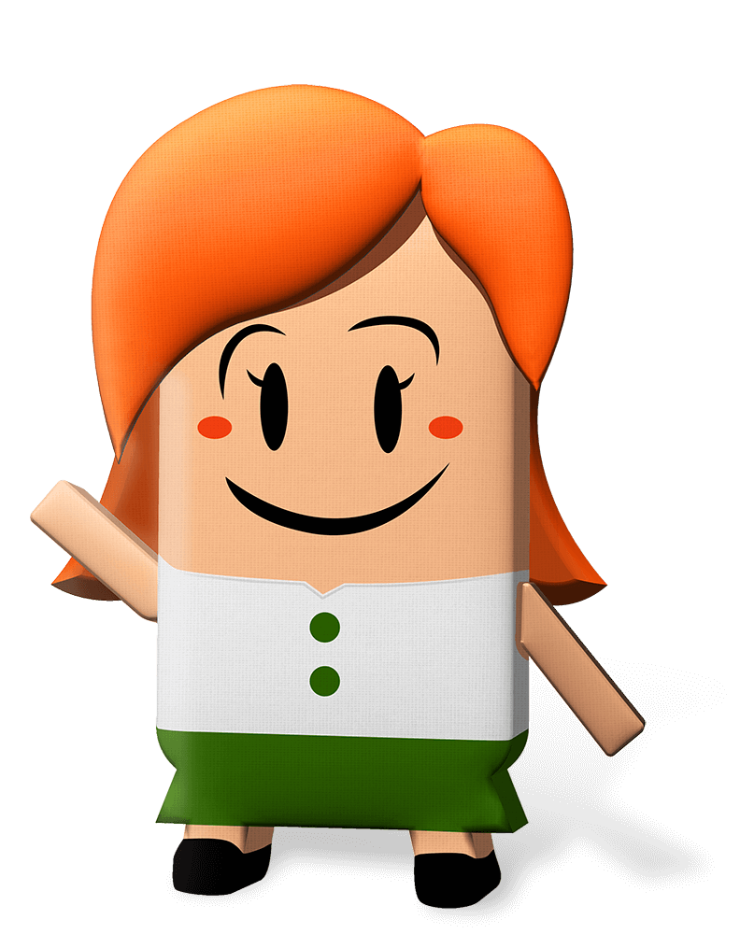
We are learning to…
Explore the idea of ‘home’
Ask questions about the United Nations Global Goals for Sustainable Development
Create an original artwork on the theme of ‘PARTNERSHIP’
Notes:
Teacher notes: Learning intentions (3 consecutive animations at * Click)
Depending on your class, you might like to share the learning intentions on this slide at the start of the lesson.
* Click to animate in the three learning intentions for this lesson, one after another, reading aloud as you go.
Sensitivity note: As their teacher, you know your own pupils well. Please feel free to edit the learning intentions and the activities in this lesson to best suit the context and needs of the children in your class.

Slide 5
Activity 1
Slide 1 of 3 | HOME: ICEBREAKER
Notes:
Teacher notes: Activity 1/Slide 1 of 3 (icebreaker) (no animation)
Sensitivity note: As their teacher, you know your own pupils well. Please feel free to edit this activity and other lesson content to best suit the context and needs of the children in your class. For example, if you have pupils in your class for whom home may be a challenging environment, you might decide to place an emphasis on the idea of ‘my favourite place, where I feel comfortable and relaxed’, rather than on the concept of ‘home’, editing the Slides 5-7 and notes for these slides accordingly.
Invite pupils to take turns saying one item they can find in their home (or their favourite place) that begins with the same letter as their first name, for example, Aoife = attic, Isabel = iron, Sophie = seat etc.
If anyone has trouble thinking of an item beginning with their initial, they can ‘phone a friend’ for some help.
Invite pupils to call out words or feelings that they associate with the idea of ‘home’ (favourite place). Depending on your class, you might like to give some of the following prompts: cosy, safe, building, family.
Record pupil feedback on the board.

Slide 6
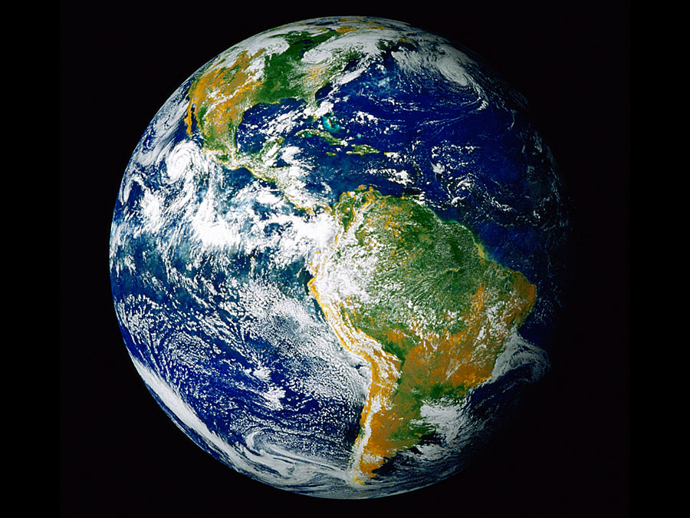
Activity 1
Slide 2 of 3 | HOME: IMAGE
Notes:
Teacher notes: Activity 1/Slide 2 of 3 (Home: image) (no animation)
Encourage pupils to call out words or feelings that come to mind as they look at the image of our world from space.
Add their feedback to the words or feelings on the board from the discussion of ‘home’ (favourite place).
If pupils do not spontaneously come up with the idea of our world as our home (favourite place), then gently suggest this concept to the class.

Slide 7
Activity 1
“There’s one home 7 billion of us share and if we’re going to solve its problems, we have to do it together.
Now there is a plan. A plan for home.”
What does the narrator mean when she says:
“A plan for home.”
https://www.youtube.com/watch?v=SqP2Tmpb6D0
Slide 3 of 4 | Home: VIDEO
Notes:
https://www.youtube.com/watch?v=SqP2Tmpb6D0

Slide 8
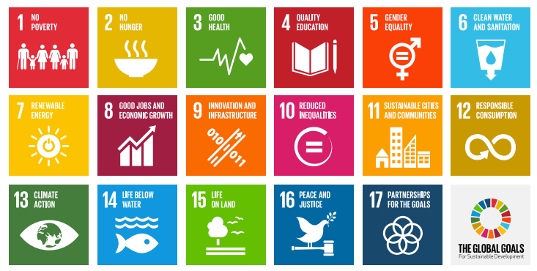
Activity 2
In 2015, the 193 member countries of the United Nations (including Ireland), agreed to work together in PARTNERSHIP to achieve 17 Global Goals by the year 2030
These Goals are a call to action to make sure that everyone, especially the people most at risk, have what they need to live well and in peace; and, to protect our home, planet earth
The Global Goals are universal – this means that they apply to everyone, now and in the future – we all have a right to these Goals; and, everyone and every country has a responsibility to work together in PARTNERSHIP and play their part in making the Goals happen.
Slide 1 of 5 | PARTNERSHIP FOR THE GOALS
Notes:
Teacher notes: Activity 2/Slide 1 of 5 (Partnership for the Goals) (3 consecutive animations at * Click)
* Click to animate in the three bullet points, one after an other, reading the text aloud as you go.
Depending on your class, and how familiar they are with the Global Goals, you might decide to read through the child-friendly version of the full text for all 17 Global Goals (see below), and/or play The Global Goals (2015), ‘The World’s Largest Lesson animation part 1’ (3 mins): https://www.youtube.com/watch?v=cBxN9E5f7pc&t=72s.
Invite pupils to ask and answer questions about the Global Goals information they have been presented with. Encourage pupils to use a mixture of question types – open, closed, leading, rhetorical – during their discussion.
Child-friendly version of the Global Goals text:
1. End poverty
2. End hunger
3. Make sure everyone can live healthy lives
4. Make sure everyone gets a good education
5. Make sure that women and girls get the same chances as men and boys
6. Make sure that everyone has access to clean water and proper toilets
7. Make sure that everyone has enough heat, light, and power without damaging the environment
8. Help countries to develop and provide good jobs in a way that benefits everyone
9. Build schools, hospitals, and roads, and promote businesses and industries that make all people’s lives better
10. Make sure that everyone is treated fairly, and that countries treat each other fairly
11. Make cities environmentally friendly and safe communities, where all people can live well
12. Make sure we do not buy too many things so that we do not use up the earth’s scarce resources
13. Act now to fight climate change
14. Look after the life in our oceans and seas
15. Look after forests, animals, and the earth itself
16. Work for peace and justice inside and between countries
17. Countries will work together in partnership to achieve the Global Goals and make the world a better place for everyone
Further information about the Global Goals available: https://sdgs.un.org/goals; https://www.globalgoals.org/

Slide 9
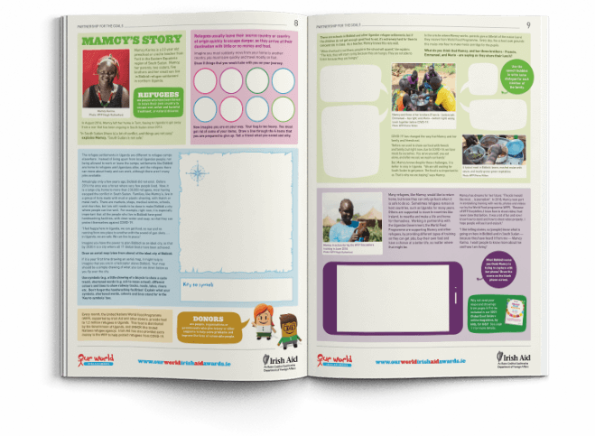
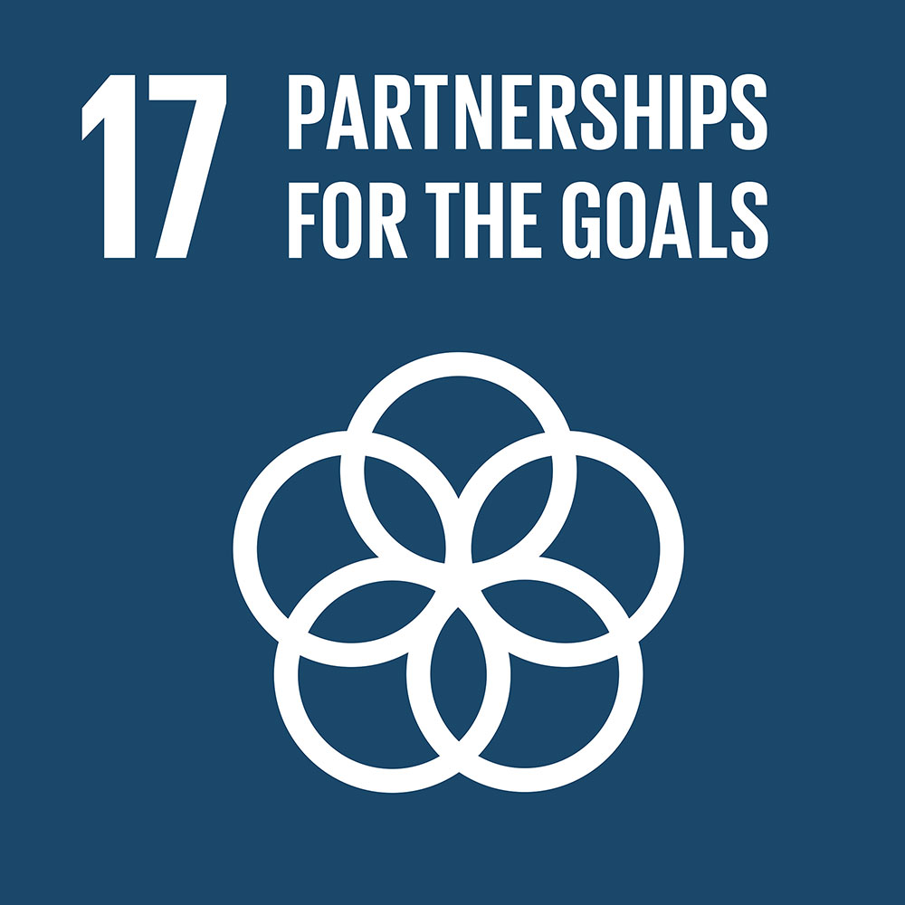
Activity 2
Slide 2 of 5 | PARTNERSHIP FOR THE GOALS
Notes:
Teacher notes: Activity 2/Slide 2 of 5 (Partnership for the Goals) (no animation)
Explain that Global Goal 17 is very important. Goal 17 is about all countries working together in partnership. Countries that have more money and resources, like Ireland, have to support countries, like Uganda, who have less so that the Global Goals are achieved everywhere. All governments have to work together with concerned people of all ages and governments have to think about the Global Goals when they are coming up with new policies or laws. Working together in partnership is a big part of making sure that all 17 Global Goals are achieved by 2030. We can all play a role as partners for the Goals – everyone can be a partner – children and young people, teachers, parents, businesses, governments and big international organizations like the European Union or the United Nations.
The Government of Ireland’s programme for overseas development cooperation is called Irish Aid. Irish Aid is working in partnership with other governments, with different groups (NGOs or charities), and with communities, in countries all over our world, to try to make the Global Goals happen; so that everyone everywhere, now and in the future, can live in a better world.
One of the examples of how Irish Aid works together in partnership for the Goals is in the 2021 Our World Irish Aid Award pupils magazine (pages 8-9) / (https://www.ourworldirishaidawards.ie/pupils-magazine/).
Mamcy Karina lives in Uganda, but she is originally from South Sudan. She had to leave South Sudan because of a war. She is now living, with her family, in a refugee settlement in Uganda. Mamcy does not know when she will be able to return home, but for now she knows she is safe in Uganda.
Mamcy and her family have enough good food to eat because Irish Aid, working in partnership with the World Food Programme (an organization that is part of the United Nations) and the Government of Uganda, give food to Mamcy and many other refugees living in Uganda. This is an example of how Irish Aid (Government of Ireland) is working with others to achieve Global Goal 2 (Zero Hunger).
Because of COVID-19, partnership for the Goals is now more important than ever. For this reason, the Government of Ireland, through the Irish Aid programme, has given extra money to the World Food Programme to help protect Mamcy and other refugees in Uganda from COVID-19.

Slide 10
Activity 2
One of the challenges of our time…is to re-instill in the consciousness of our people that sense of human solidarity, of being in the world for one another…
NELSON MANDELA
1918-2013
Slide 3 of 5 | PARTNERSHIP FOR THE GOALS
Notes:
Teacher notes: Activity 2/Slide 3 of 5 (Partnership for the Goals) (no animation)
Ask pupils if anyone recognises the man in the photograph (Nelson Mandela).
Explain that Nelson Mandela was born in South Africa in 1918 and died in 2013. He believed that everyone should be treated fairly and be given the same chances in life, regardless of colour or background. Mandela spent many years in prison in South Africa for objecting to an unfair system (apartheid) where black people were treated as less than white people. He was elected and served as the first black President of South Africa from 1994-1999.
Depending on your class, you may wish to locate South Africa on a map of the world.
Explain that in the quote on the slide, Mandela was saying that everyone in our world needs to wake up to the fact that we all belong to the same human family and that we need to support and be kind to others. Mandela was talking about the importance of partnership between humans, whether they live far away or close by.

Slide 11
Activity 2
Slide 4 of 5 | PARTNERSHIP FOR THE GOALS
Notes:
Teacher notes: Activity 2/Slide 4 of 5 (Partnership for the Goals) (1 animation at * Click)
Remind the class that partnerships are a big part of making sure that all 17 Global Goals are successfully achieved by 2030. That means everyone working together collectively and also individual people, like each person in the class, making good changes and taking action about one or more of the Goals.
* Click to animate the split of the 5 circles from the Global Goal 17 icon into 5 separate circles.
Explain that each pupil is going to get a piece of paper with a circle, one of the five circles on the right of the slide (worksheet available Slide 12). They are going to work individually to create a circular stained glass window, inspired by the idea of ‘partnership’ (stained glass window instructions below).
Depending on your classroom layout and guidance related to physical distancing etc, you might decide to encourage pupils to collaborate in groups of 5 before creating their individual circular windows, or you can instruct them to work individually from the start.
As they plan their ‘partnership’ window, remind pupils to think about the idea of our planet as our home, about the 17 Global Goals, and in particular to think about the importance of working together in partnership for achieving the Global Goals.
Depending on your class, you might like to use the following prompt questions to get pupils thinking about what they might include:
Can you explain what partnership means in your own words?
What are the different ways you work together in partnership in class? What about outside of school or at home?
What happens when you work in together in partnership with someone else? (does it take less effort? less time? a better result or outcome?)
Does conflict ever arise between partners? Are there ways around this?
How does it make you feel when you know you have partners (teacher, friends, family) that you can ask for help or work with someone to help yourself or others?
Can you draw this feeling?
What colours, shapes/patterns or things to draw would you pick to show or describe how it would feel to know that everyone and all countries were working together in partnership for our planet/our home?
Stained glass (circular) window instruction:
Distribute a copy of Slide 12 to each pupil.
Tell pupils to use crayons to draw something/someone/a scene to show their thoughts about the idea of ‘partnership’ inside the circle on their page.
Using a paint brush, they should paint olive oil over their drawing and leave to dry for 24 hours.
Then, stick the 5 completed circles together, as per the icon for Global Goal 17.
Present their artwork in class and display it on a window/wall in the classroom.
Consider submitting a photo of your pupil’s finished artwork for publication in one of our 2021 Global Goal Getters online magazines, by kids, for kids…for more details see Slide 13!

Slide 12
Activity 2
Slide 5 of 5 | PARTNERSHIP FOR THE GOALS
Notes:
Teacher notes: Activity 2/Slide 5 of 5 (Partnership for the Goals) (PUPIL WORKSHEET – see notes Slide 11)

Slide 13
Activity 3
Slide 1 of 2 | GLOBAL GOAL GETTERS
Notes:
Teacher notes: Activity 3/Slide 1 of 2 (Global Goal Getters)
Explain to the class that they are going to take part in the Our World Irish Aid Awards. This means producing short stories, poems, surveying others, performing songs, drawing etc – about the theme of Partnership for the Goals, the Global Goals generally, or the work of Irish Aid. All of this great work will then be submitted for publication in one of the three Global Goal Getters online magazines by kids, for kids (submit by 4th December 2020 to be included in the February 2021 edition!).
Depending on your class, you might like to:
give pupils the freedom to choose the content and format of their submission
allocate different content/formats to groups of pupils
decide on content focus and format and make a class submission
The deadline for the February edition of the Global Goal Getters magazine is 4th December 2020. Please complete an Entry Form (available in your teacher pack or for download from our website) and submit your work via email: ourworld@realnation.ie or by post to: Our World Irish Aid Awards
Real Nation
24 Arran Quay Dublin 7
D07 W620 Content that is submitted after the 4th December date may appear in a later edition of the magazine.
If you submit, we will contact you with an invitation to take your involvement one step further and provide you with more fun and engaging lesson plans! Further information is available: www.ourworldirishaidaward.ie You can also email or ring our project office if you have any queries about the Our World Irish Aid Awards or submission details E: ourworld@realnation.ie / P: 01 522 4834H
We would love to hear about how you are getting on with the curriculum materials and Award entries. You can share your Our World Irish Aid Awards 2021 journey with us @Irish_Aid / @ourworldirishaidawards on social media using the hashtag #ourworldawards

Slide 14
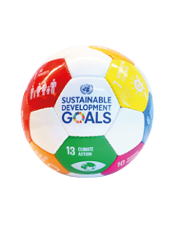
Activity 3
We have learned to…
Explore the idea of ‘home’
Ask questions about the United Nations Global Goals for Sustainable Development
Create an original artwork on the theme of ‘partnership’
Well done class!
You’re all amazing Global Goal Getters!
Slide 2 of 2 | Global Goal Getters
Notes:
Teacher notes: Activity 3/Slide 2 of 2 (Global Goal Getters) (4 animations * Click – 3 come in one after another on the 2nd Click)
Explain to pupils that they are going to think about (reflect) on what they have learned in this lesson.
Invite pupils to imagine they are playing basketball. As each of the things they were learning in this lesson appear on the screen pupils should mime:
Shooting and scoring the winning basket in the match – if they are happy that they have learned what they were supposed to learn
* Click to animate the ball dropping into the net to demonstrate what you mean
Dribbling the ball – if they need some more support from a partner (pupils or teacher) to be able to say that they have learned what was intended
* Click to animate each of the 3 learning intentions for this lesson in separately, reading each aloud as they appear.
Observe pupils to see who might need some extra support.
Reassure the class that they have done an amazing job and that they are all fantastic Global Goal Getters.
Don’t forget to check out www.ourworldirishaidaward.ie for information about how to get your pupils work published in one of our online Global Goal Getters magazines in 2021.

Slide 15
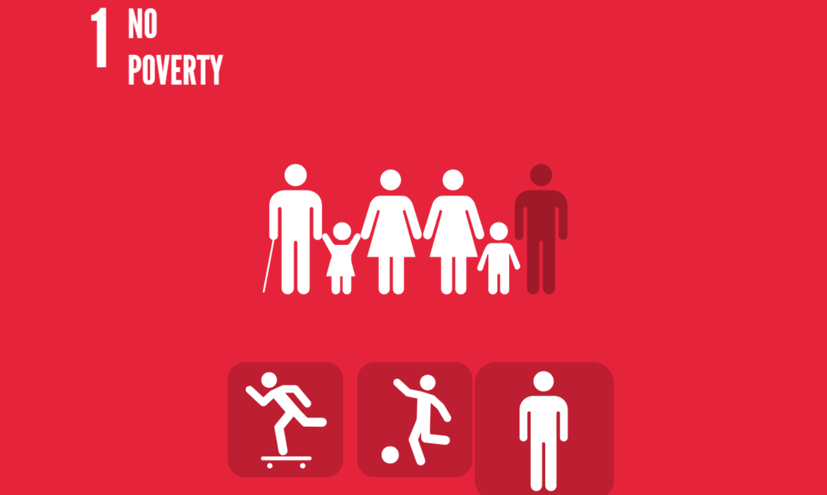
In your own time…
https://gamethegoals.com/
Notes:
Teacher notes: In your own time (no animations)
Depending on your class, you might like to encourage them to test their knowledge of the Global Goals by competing against the clock in the online Game the Goals quiz, available: https://gamethegoals.com/

